Slide 1
Macro Strategy
May 2025
May 2025
• Document for professional investors only

Slide 2
Contents
Guidelines:
Contents are fixed according to the meeting structure and are meant to be consistent across all investment platforms
Main Scenario – Cross Asset Research & Portfolio Construction
DM Rates
DM Equity
DM Credit
EM Equity
EM Debt
Global FX
Commodities
Hedging
Asset Class

Slide 3
Macro Strategy Day
Main Scenario – Portfolio Construction
May 14th, 2025

Slide 4

Strategic Portfolio - Positioning
Insert a new slide:
Click on Home menu / Slides / New Slide
Select the appropriate slide in the Gallery.
Change the layout of slide:
Click on Home menu / Slides / New Slide,
Select the appropriate slide in the Gallery.
Change text level to another one:
In the Home menu:
click to the following buttons
With the tab key:
Next level
Previous level
 With the tab key, it is advisable to select all the text to change level
⇥
⇥
+
⇧

Slide 5
Strategic Portfolio - Positioning
Insert a new slide:
Click on Home menu / Slides / New Slide
Select the appropriate slide in the Gallery.
Change the layout of slide:
Click on Home menu / Slides / New Slide,
Select the appropriate slide in the Gallery.
Change text level to another one:
In the Home menu:
click to the following buttons
With the tab key:
Next level
Previous level
 With the tab key, it is advisable to select all the text to change level
⇥
⇥
+
⇧

Slide 6
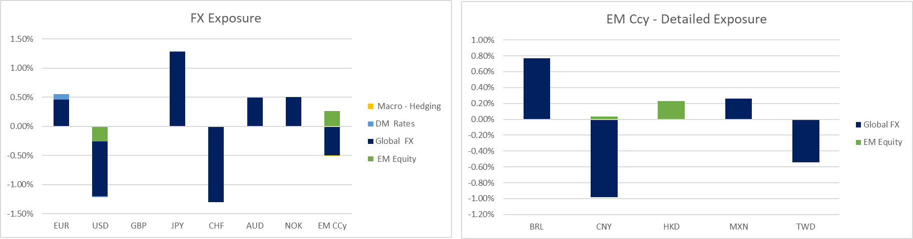
Strategic Portfolio – FX Exposure
Insert a new slide:
Click on Home menu / Slides / New Slide
Select the appropriate slide in the Gallery.
Change the layout of slide:
Click on Home menu / Slides / New Slide,
Select the appropriate slide in the Gallery.
Change text level to another one:
In the Home menu:
click to the following buttons
With the tab key:
Next level
Previous level
 With the tab key, it is advisable to select all the text to change level
⇥
⇥
+
⇧

Slide 7
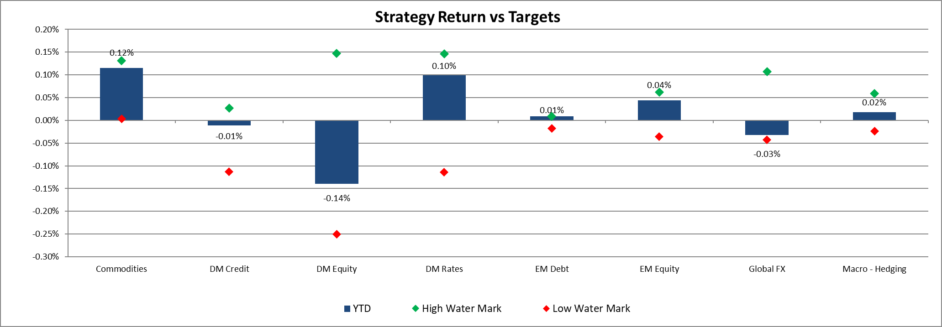
Strategic Portfolio – Performance up to 9th May (Absolute Performance -2.55%)
Insert a new slide:
Click on Home menu / Slides / New Slide
Select the appropriate slide in the Gallery.
Change the layout of slide:
Click on Home menu / Slides / New Slide,
Select the appropriate slide in the Gallery.
Change text level to another one:
In the Home menu:
click to the following buttons
With the tab key:
Next level
Previous level
 With the tab key, it is advisable to select all the text to change level
⇥
⇥
+
⇧

Slide 8
Cross Asset Research Amundi Investment Institute
Monthly update
May 2025
• Document for professional investors only

Slide 9
Contents
Portfolio update
Dynamic Asset Allocation
Profits cycle
Macro Wealth Indicator
Valuation
Tactical Asset Allocation

Slide 10
Portfolio update
01

Slide 11
Remain pro-risk this month adding equities and reducing High Yield
Cross Asset
Portfolio update
Marginally increase OW in Equities. Downgrade in HY, Upgrade in Govies and Cyclical Commos. Increase duration.
Main takeaways
Profits forecast remain quite volatile subject to very unpredictable tariffs negotiations. We readjust to 5% our 25 target for profits. Still less than consensus but the gap is starting to close; today analysts expectations are for 10% growth in 25.
Despite uncertainty on profits we increased OW in Equities due to resilience demonstrated by key sectors (especially high tech) and overall macroeconomic stability. Neverthe less this is a tactical adjustment and not a structural rerisk.
Risky assets: 1) OW Equities (+160 BPS) and HY (+90 BPS vs +116bps last month).
Govies & IG: Upgrade IG (+136 BPS) and govies (+94 BPS).
Commodities: constructive view on cyclical (+90 BPS). Maintain OW on Gold

Slide 12
AA: Economic backdrop is calling for moderate risk exposure favouring equities to HY. Valuation positive for rates and Cyclicals commos.
Cross Asset
Portfolio update
Rationale
Late cycle still remains the central case for the next quarters although correction phase probability has lifted to 32%. 5% profits growth coherent with this downside risk probability.
MWI remains above threshold, but the weaker growth metrics and the lower liquidity in April are responsible for the downward revision vs last month
MWI bounced back last month on falling CPI and PPI inflation.
Whilst the index struggles to call for an UW in risk, some dimensions are deteriorating and suggest low OW positions
Protection is still above threshold. Wealth effect is not falling much, given the rapid bounce in stocks. Refinancing is also falling, thus insulating households pockets.
Valuation looks more expensive after the rebound in risky assets; current rates seem supportive on duration exposure after recent movement in rates and repricing of FED expectations.
We said no signs of capitulation months ago despite the sharp correction hence not related to fundamentals. Today we start to see some signs of less supportive risk sentiment.
Catalysts to monitor are: inflation on macro side, EPS revisions and potential pass through to credit conditions of rates volatility on fundamental side.

Slide 13
Profits reality check: Top line mixed
Main takeaways
Labor market leads top line as unemployment rate remains low.
GDP weak but for one off reasons. Consumption and in general growth remain round median and is expected to moderate further. Capex deteriorated recently
Manufacturing and global trade still at weak levels and vulnerable to external and geopolitical shocks.
USD depreciation should help revenues abroad.

Slide 14
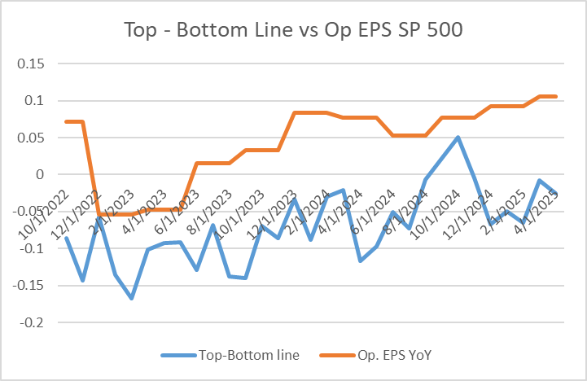
Profits reality check: Bottom line
Main takeaways
Labor costs under control and below 2%.
Producer prices moved down recently; to check in the next months with tariffs impact.
Credit conditions deteriorated recently but still not ad alert levels
Profits markup combining top and bottom line still mildly supportive and in line with 2025 positive growth (high single digit number)
To check next months: PPI, Credit spread. Second leg of downward revisions likely.

Slide 15
Profits reality check: Bottom line the risk
Producer prices can be barely impacted by tariffs with some potential spillover to credit conditions

Slide 16
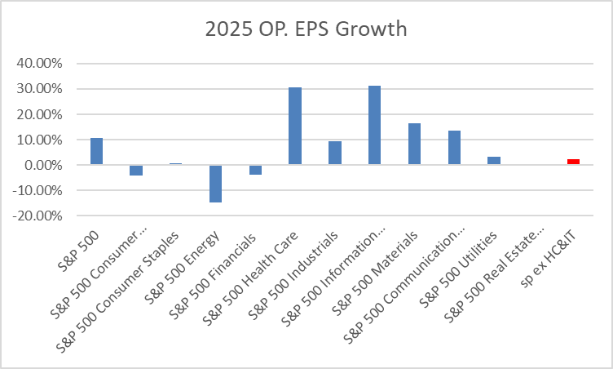
Profits reality check: Gradual Downward revision
So far downward revision occurred in a smooth way, also in Tech sector. Today 2025 forecast more less irrealistic than months ago (10% exp growth for SP 500 OP. EPS, Dwn.rev. by 3.2%)

Slide 17
02
Macro Wealth Index

Slide 18
Macro Wealth Index
Motivation: the 2023 puzzle, disinflation with no recession
Weak macro sentiment did not anticipate strong growth/strong rally
Inflation on the contrary fell opening the way for Goldilocks
The music didn’t change in 2024: higher rates, higher inflation, but still strong markets
The need: more accurate information, condensed in one index
Macro wealth Index [MWI]: synthetic indicator to scale macro risk allocation
We check for public and private sectors, then go into consumers and corporates dynamics
MWI = (GROWTH + REVENUES) – [ COSTS - BALANCE SHEET PROTECTION ]
Broad business sentiment
Recession alerts
Manufacturing/industrial activity
Services activity
Small Business sentiment
Construction activity
Labour market conditions
Consumption and Consumption sentiment
Retail sales
Corporate sales and margins
Wages
Income/savings dynamics
Interest rates (front-end, long-end, mortgages, credit cards and auto loans)
Sentiment on rates
CPI inflation and sentiment
PPI (finished goods, final and intermediate demand)
CPI/PPI, PPI(fd)/PPI(id)
Housing wealth
Refinancing activity
Saving rates on deposits/certificates
Corporates current ratios
Households wealth (A&L)
Corporate non-financial wealth (A&L)
US liquidity (FED BS)

Slide 19
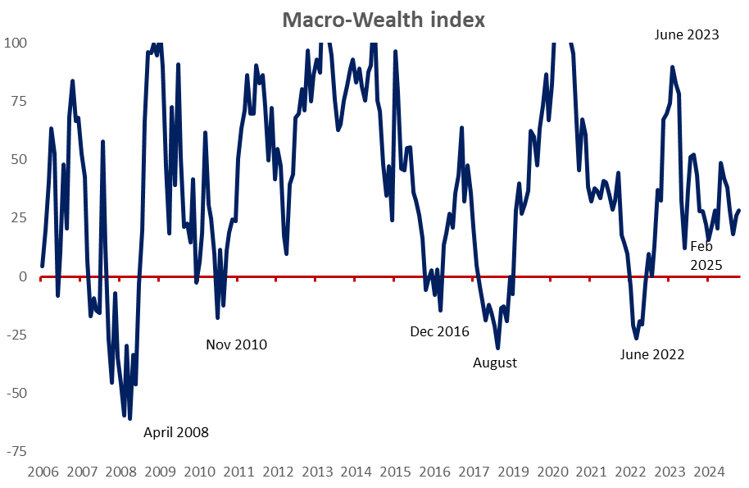
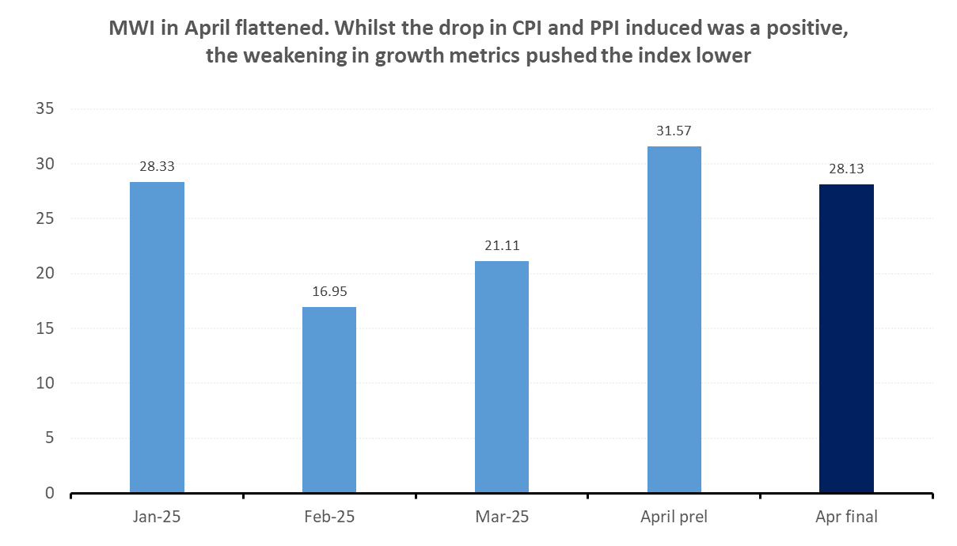
Macro Wealth Index update
MWI remains above threshold, but the weaker growth metrics and the lower liquidity in April are responsible for the downward revision vs last month
Source: Bloomberg, Amundi Investment Institute, Bloomberg. Data is as of April 30, 2025

Slide 20
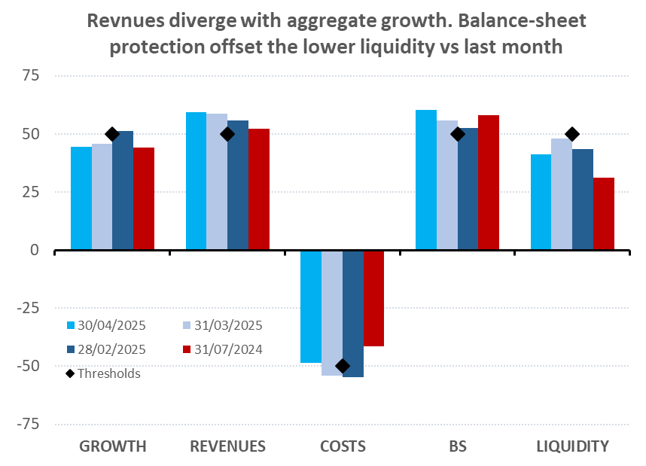
Macro Wealth Index today
Mixed signals in April 2025. The index remains positive, but few dimensions are not moving in the right directions.
MWI bounced back last month on falling CPI and PPI inflation.
Growth metrics are deteriorating, especially on consumer expectations, now at all time lows.
Whilst the index struggles to call for an UW in risk, some dimensions are deteriorating and suggest low OW positions
Aggregate growth proxies and liquidity are both down vs last month, partially offset by rising BS protection and revenues (retail sales/wages)
We are waiting for PPI data to update our margins proxy
Source: Bloomberg, Amundi Investment Institute, Bloomberg. Data is as April 30, 2025

Slide 21
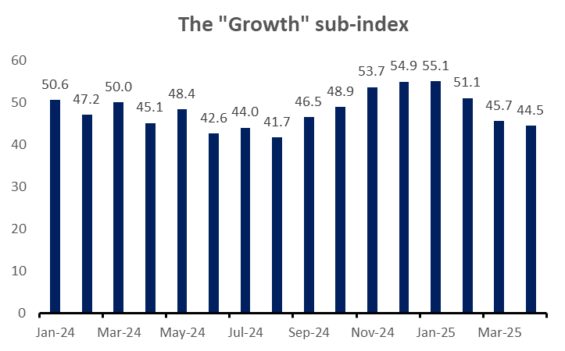
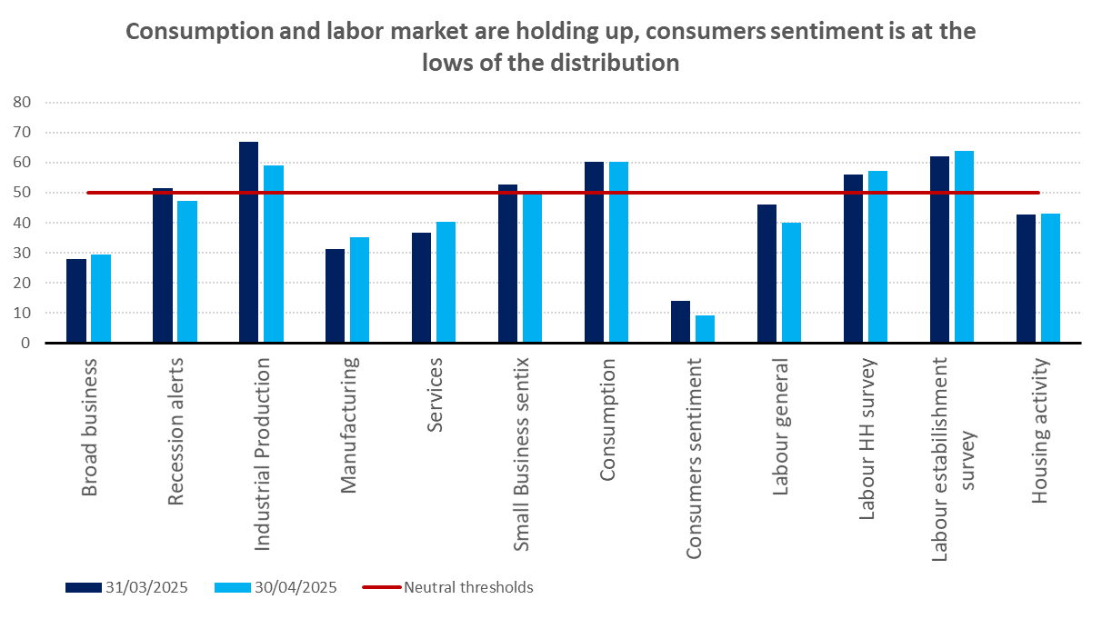
MWI: GROWTH drivers deteriorated
Growth proxies turning lower in April and the aggregate index remains below the threshold line (50). Consumer expectations are close to the all time lows.
Source: Amundi Investment Institute, Bloomberg. Data is as of April 30, 2025

Slide 22
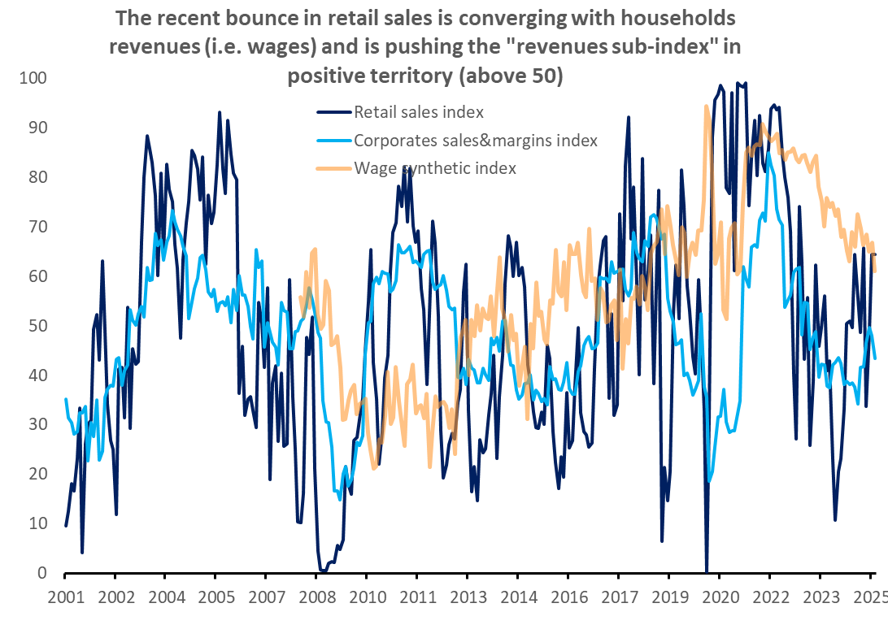
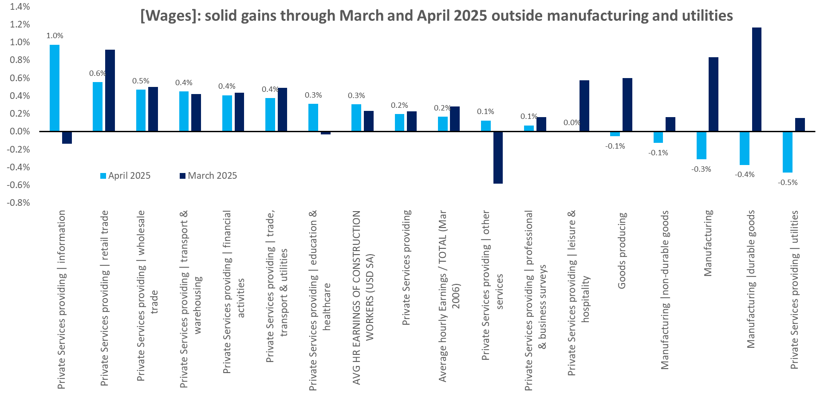
MWI: GROWTH drivers deteriorated
Revenues remain solid though. The recent jump in retail sales is catching up with wages, which are anyway decelerating (a good signs for inflation, less so for purchasing power)
Source: Amundi Investment Institute, Bloomberg. Data is as of April 30, 2025

Slide 23
MWI: GROWTH drivers deteriorated
The establishment survey remains in good shape. The government sector is adding fewer jobs, but the pace for private jobs is still not far from last year. this is key to sustain consumption, but for a continuation corporates need solid margins
Source: Amundi Investment Institute, Bloomberg. Data is as of April 30, 2025

Slide 24
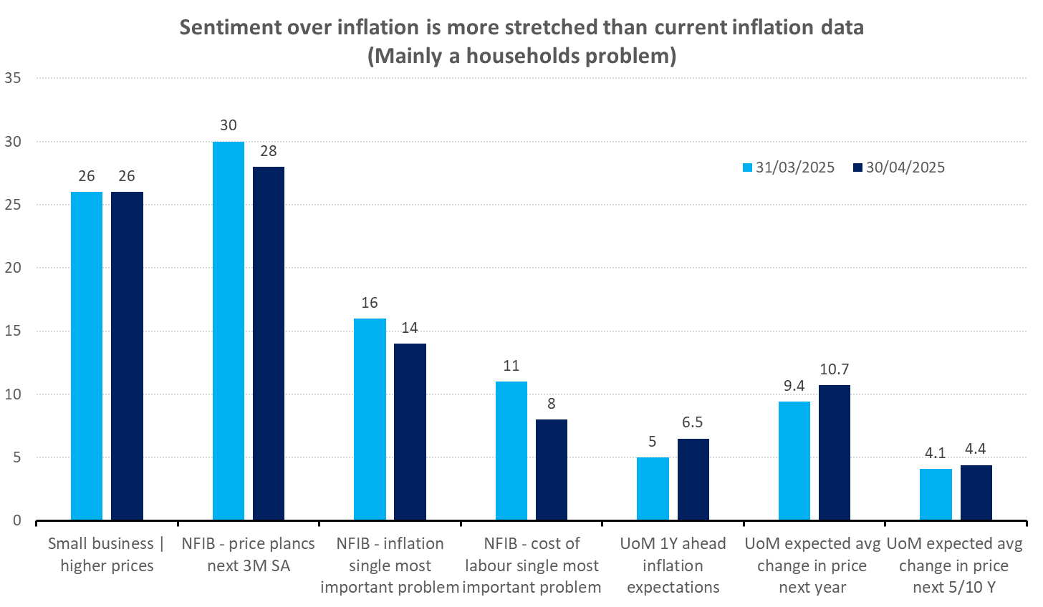
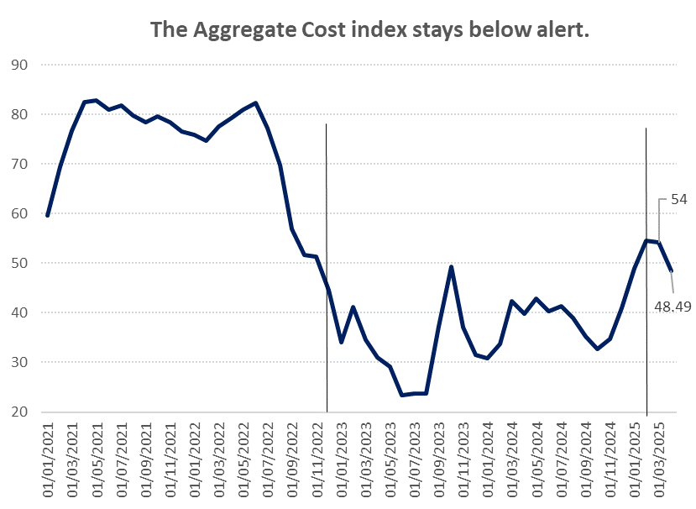
MWI: COSTS drivers [rates, inflation]
The aggregate “Costs index” remains below alert. Inflation expectations (among the costs metrics we take into account) are much more stretched than current inflation data
Source: Amundi Investment Institute, Bloomberg. Data is as of March 31, 2025

Slide 25
MWI: COSTS drivers [inflation]
Inflation deep-dive
3M annualized inflation is already below target. The same is true for super core, which is gradually falling
Services inflation remain the hottest contributors
If we focused on the recent trend, everything is getting less and less of a problem.
All items is registering low 3M annualized and is just above target in YoY terms
Energy remains negative
Energy services is a problem, but has a low weight in the basket
Services and super core is also encouraging.
Source: Amundi Investment Institute, Bloomberg. Data is as of January 2025

Slide 26
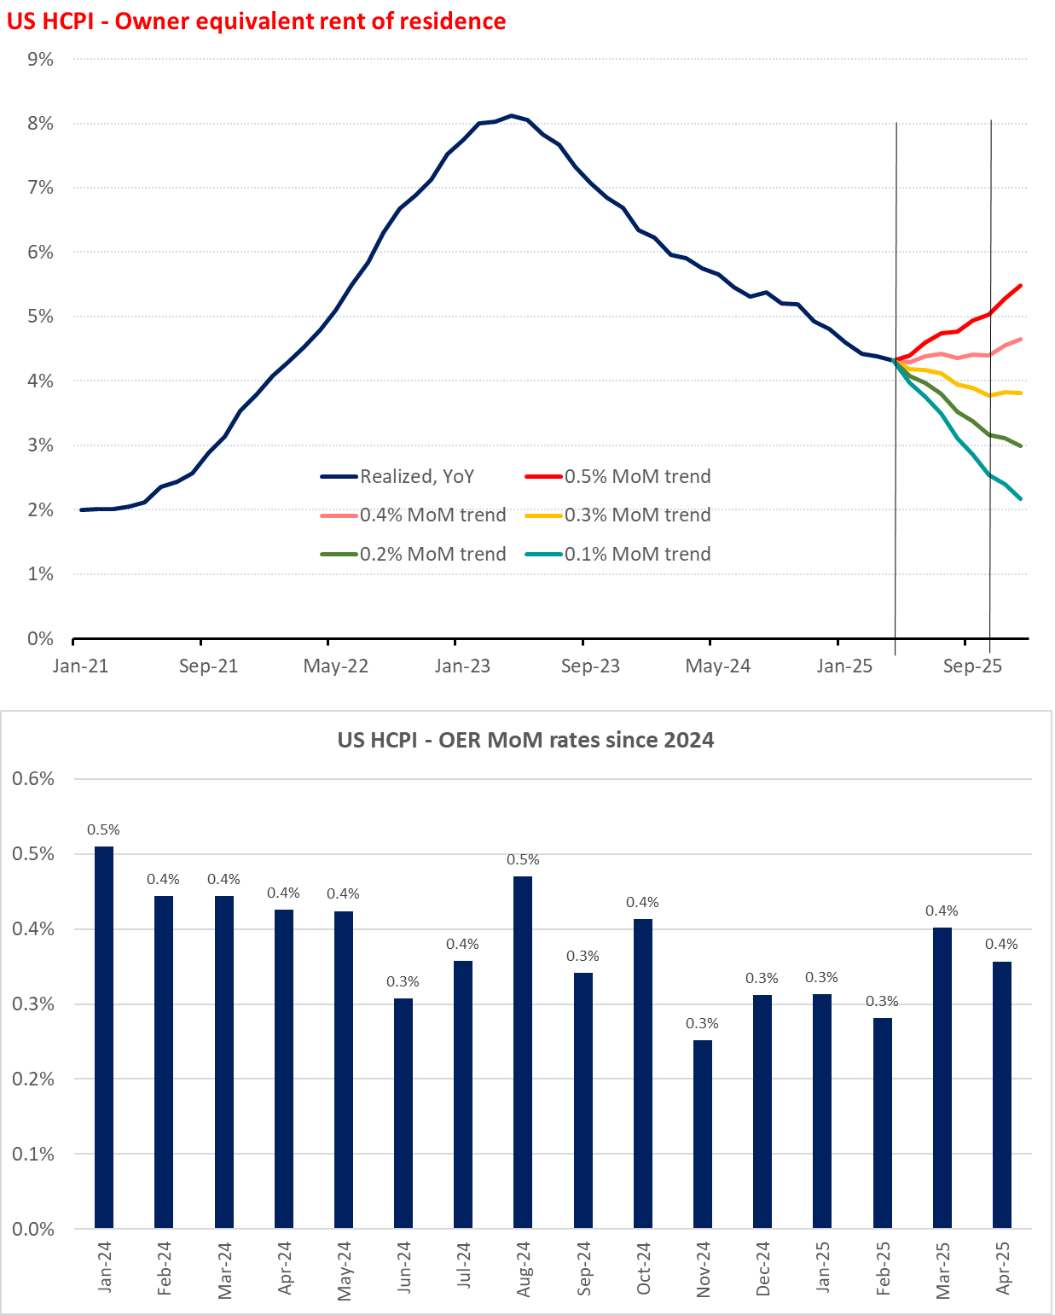
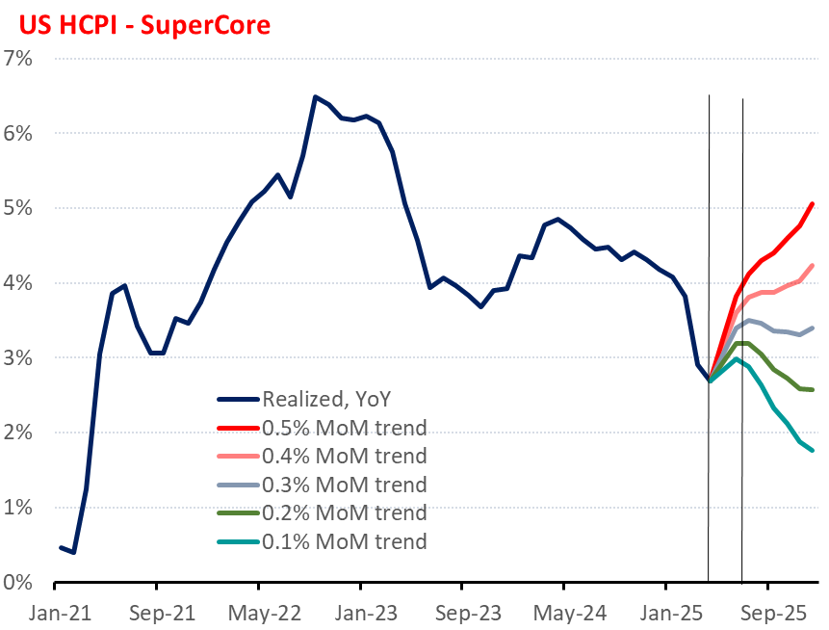
MWI: COSTS drivers [inflation]
Inflation deep-dive
Base effects on SuperCore will not be supportive anymore from here. OER needs <0.4% MoM to keep falling in YoY terms
Source: Amundi Investment Institute, Bloomberg. Data is as of March 30, 2025

Slide 27
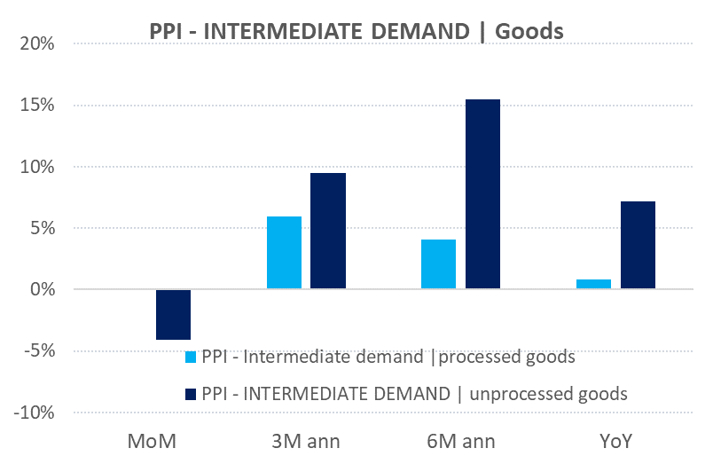
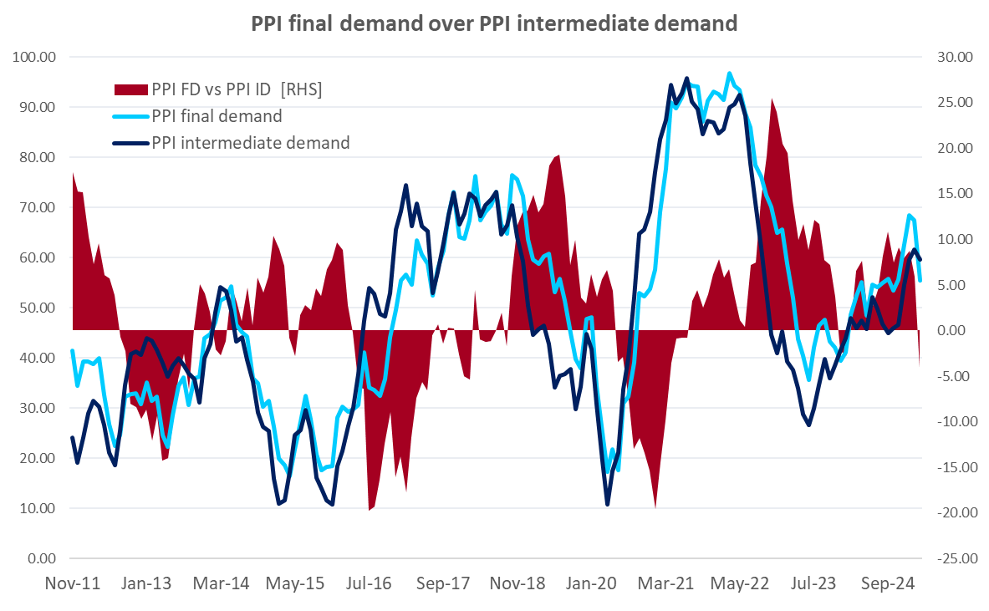
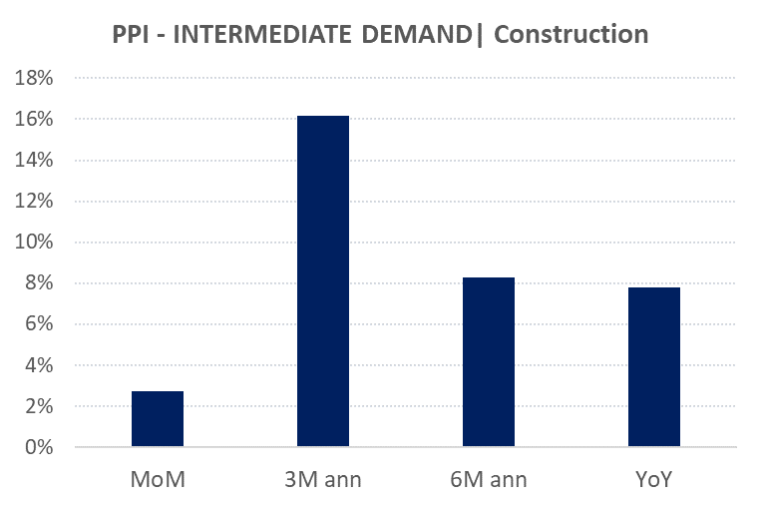
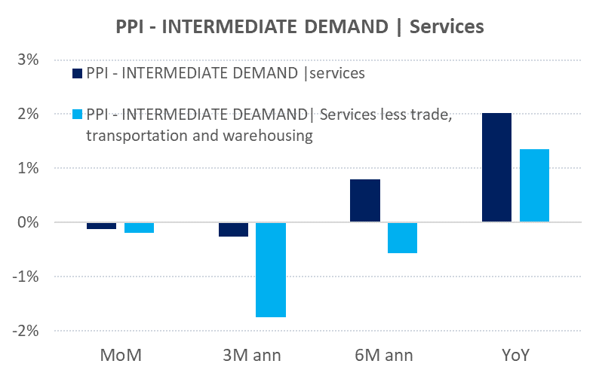
MWI: COSTS drivers [rates, inflation]
Waiting for April data, this is the picture as of March 2024 (discussed already last month)
PPI final demand/PPI intermediate demand is dropping hard. It is mainly for goods and construction, no pressures on services here
Source: Amundi Investment Institute, Bloomberg. Data is as of March 31, 2025

Slide 28
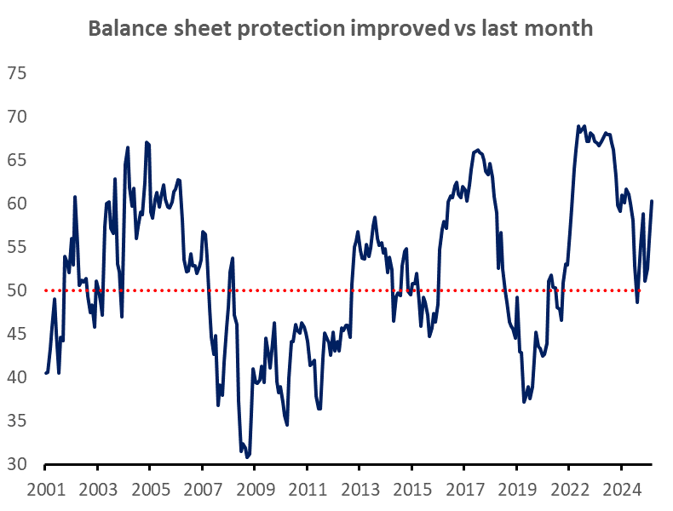
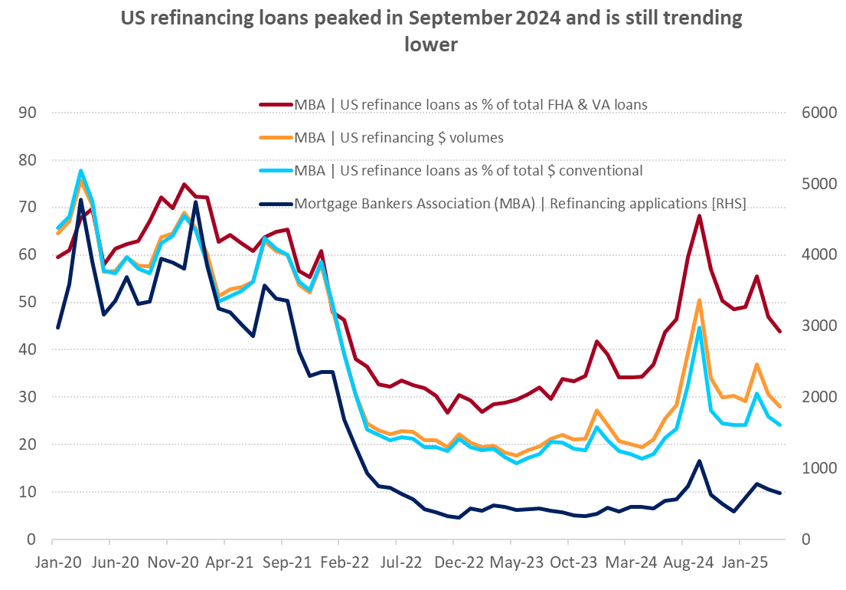
MWI: BALANCE SHEET PROTECTION [wealth, liquidity]
Protection is still above threshold. Wealth effect is not falling much, given the rapid bounce in stocks. Refinancing is also falling, thus insulating households pockets
Source: Amundi Investment Institute, Data is as of December 31, 2025
Source: Amundi Investment Institute, Data is as of April 30,, 2025.

Slide 29
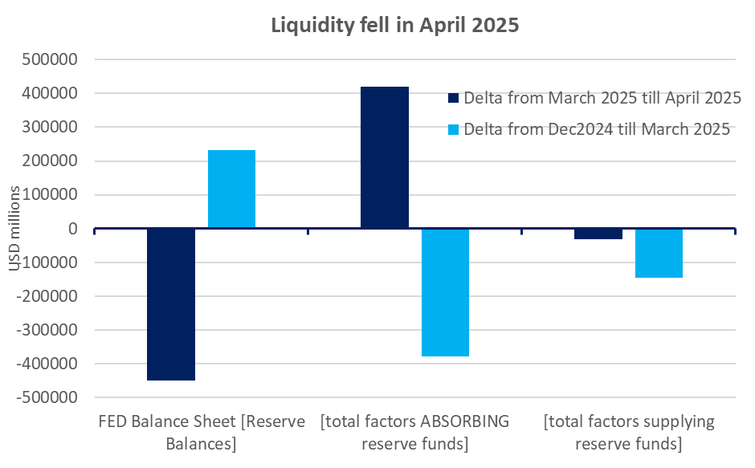
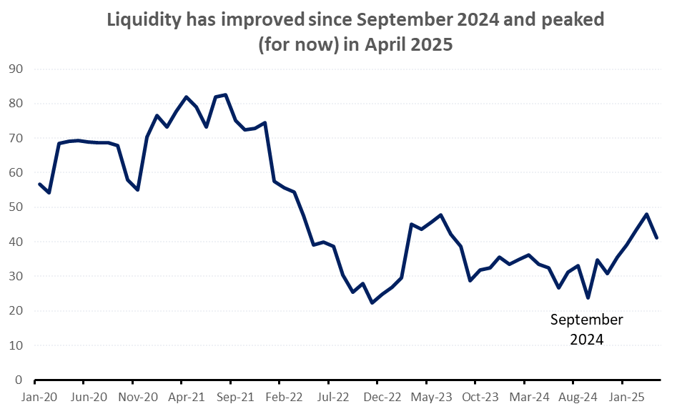
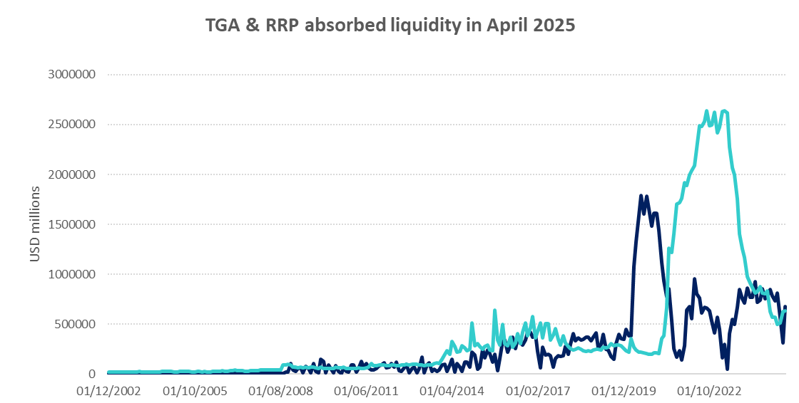
MWI: BALANCE SHEET PROTECTION [wealth, liquidity]
Liquidity has fallen in April. TGA & RRP (factors absorbing liquidity) are the main reasons
Source: Amundi Investment Institute, Data is as of April 30, 2025

Slide 30
02
Valuation

Slide 31
Allocation from Valuation
DAA: Valuation
No cheap risky asset although equities is far less expensive; Duration is not expensive, but vulnerable to risk of long inflation expectations
Data as of April, Cross-Asset Research calculation

Slide 32
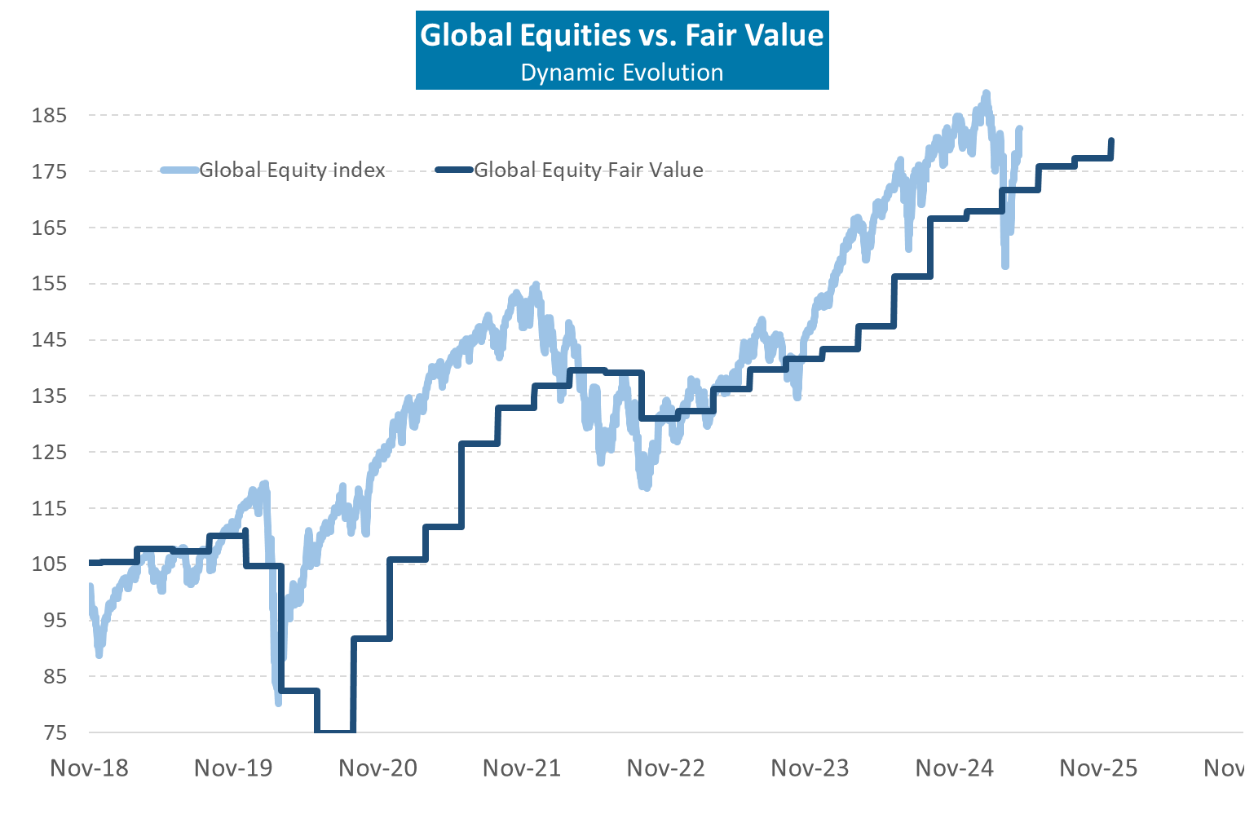
Equities move close to macro Fair value after recent selloff
DAA: Valuation
Global Equity
Data as of Apr 10 25, Cross-Asset Research calculation

Slide 33
Valuation metrics: SP 500 looks expensive

Slide 34
Valuation metrics: Equally weighted SP looks less expensive

Slide 35
Valuation metrics: Equally weighted SP looks less expensive

Slide 36
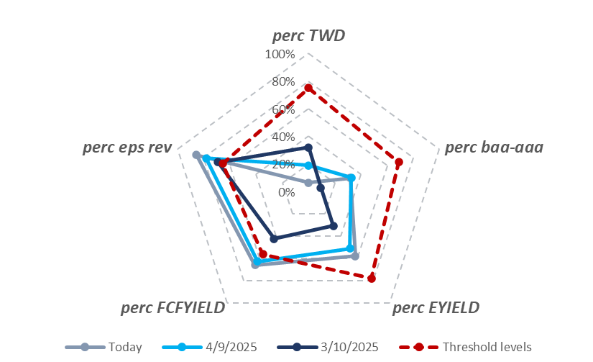
Liquidity & credit healthy conditions with optimistic view on profits provide complacent reading in valuation
Overall sell off probability is still below threshold as 3 out 5 sentinels are below their threshold (TW$, BAA-AAA spread, Earning Yield adj. for BAA-AAA spread).
What we should monitor going forward:
2. Earnings revision pass trough to BAA-AAA widening with a repricing of Earnings Yield and FCF Yield adj. for Credit spread.
3. 100 bps BAA-AAA has been historically an inflection point. This time 75-80 BPS should be enough for a meaningful correction due to absolute significantly expensive Sp 500. @ 75-80 BPS, EY adj. for BAA-AAA would move above threshold.

Slide 37
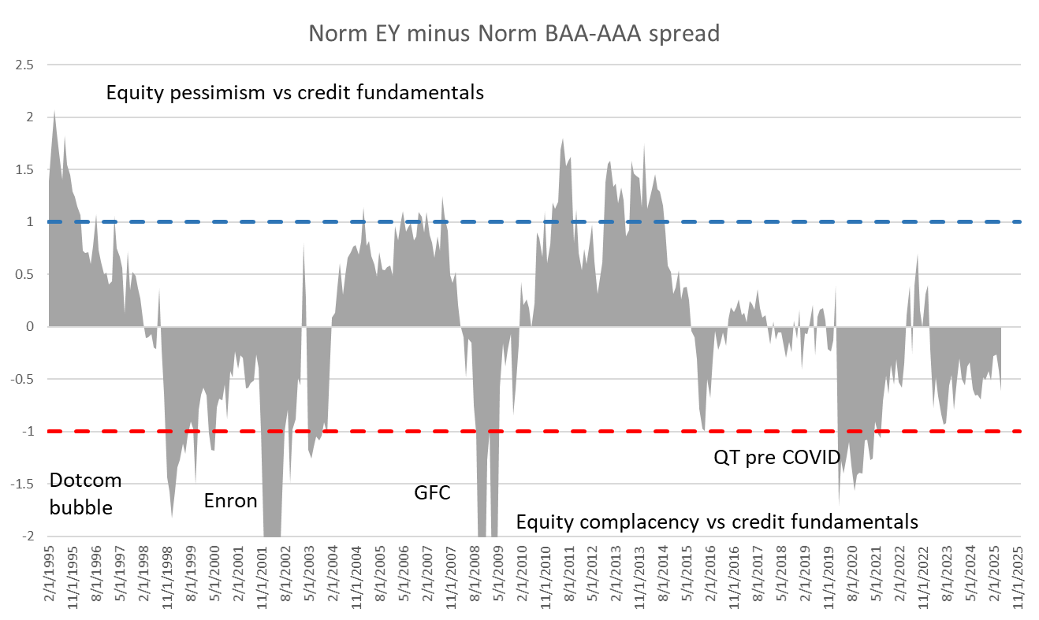
After the correction, Adjusted for credit conditions Equities look further less expensive than dotcom bubble, GFC, 15 profit recession Covid and 2022.

Slide 38
Yield Curve Nelson Siegel Macro Fair Value
Cross Asset Research – Amundi Investment Institute
MAY 2025
• Document for professional investors only

Slide 39
US curve fair value for Q1 2026 scenario
DAA: Valuation
Yield Curves (US)

Slide 40
US 10Y current macro fair value: 4.10%
DAA: Valuation
Yield Curves (US)
Since last Main Scenario update the macro fair value of the Treasury has moved higher
At 4.47% US 10Y is dislocated by a few bps
US 10Y yield too high vs fundamentals

Slide 41
Markets pricing of medium term FED rates has been cyclically moving within the 3-4% range since the last FED hike

Slide 42
DAA: Valuation
Yield Curves (US)
US 10Y and 30Y valuation ranges

Slide 43
US 2Y and 5Y valuation ranges
DAA: Valuation
Yield Curves (US)

Slide 44
US curve slope
Both the 2-10Y and 5-30Y bear flattening on FED cuts priced out materially month to date

Slide 45
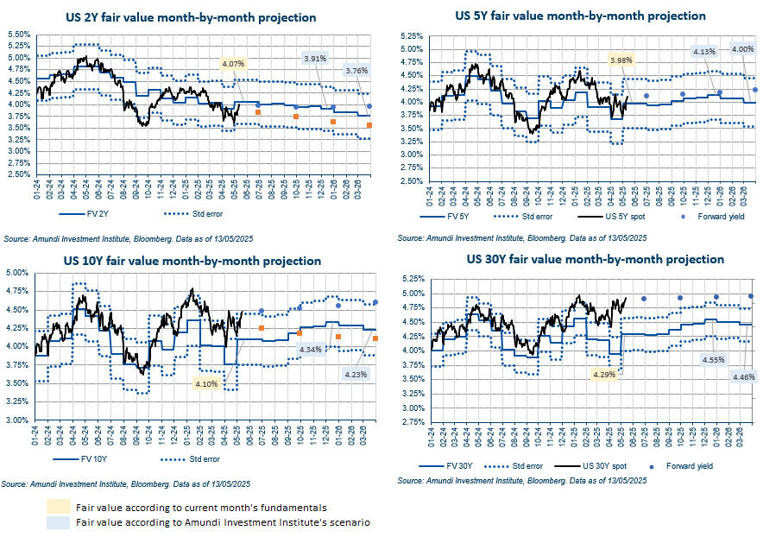
Fair values using current market pricing for FED
(*)
(*)
(*)
(*)
(*) FED pricing implied by markets

Slide 46
Short term inflation expectations and FED path have been diverging (but trade de-escalation has already started reducing the gap)

Slide 47
US 5Y5Y inflation swap and trade uncertainty
Long term inflation expectations have moved lower in line with fundamentals (mainly oil price). Despite the huge spike in trade uncertainty (almost 3 times August 2019 level), 5Y5Y inflation swap has not undershot
Jan 2018-Dec 2019: Trump 1.0 tariffs

Slide 48
Front end break-evens correcting lower but more room to go according to fundamentals
Current WTI targets: Q4 2025 @ 59$ brl, Q4 2026 65$ brl

Slide 49
Fixing for April US CPI data lower than consensus
Lower effective tariff rate exerting steepening pressure on 2-10Y BEI
April US CPI | Swaps | Consensus
MoM | 0.14% | 0.3%
YoY | 2.3% | 2.4%

Slide 50
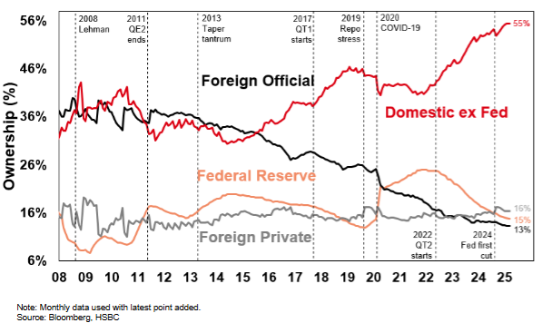
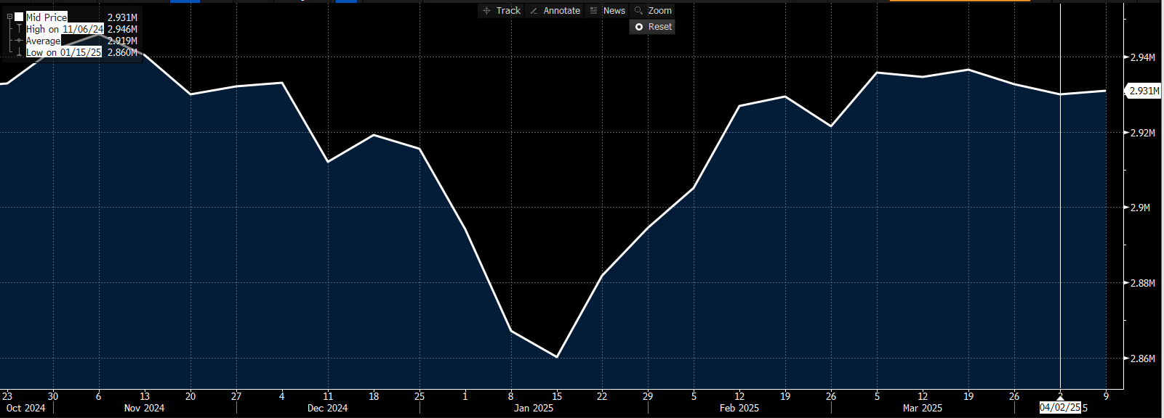
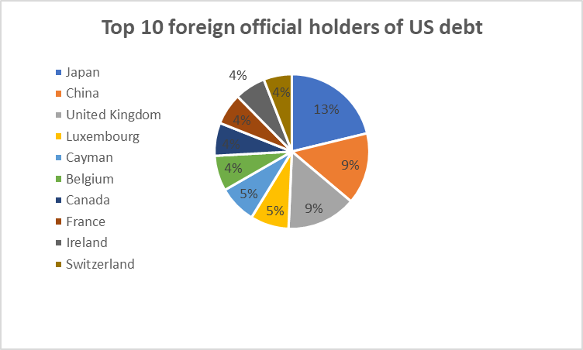
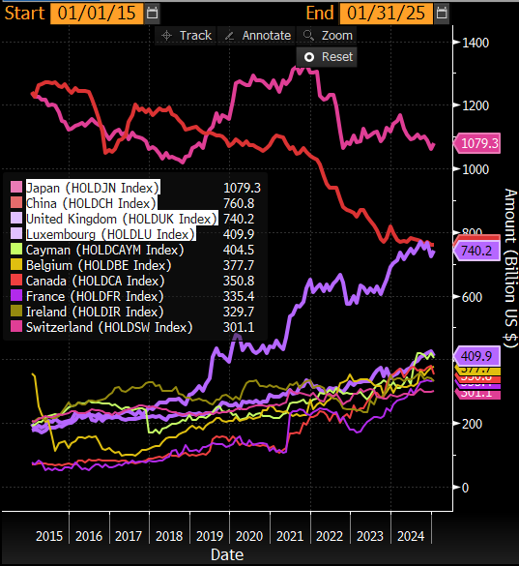
Holders of US debt
US Treasury Securities Held in Custody Foreign Official & Intl Accounts Average
Top 10 historical foreign holders evolution

Slide 51
From balance sheet reduction to maintenance soon?
FED Reserves on Nominal GDP slightly below balance sheet maintenance level (in the higher scenario of “ample” reserves)

Slide 52
Term premium reflects FED curve shape: medium term – short term FED expectation

Slide 53
US curve Nelson Siegel term premium proxy

Slide 54
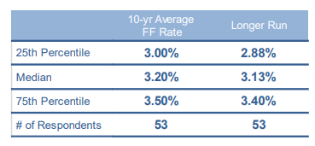
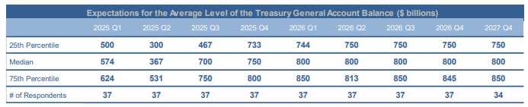
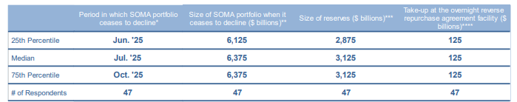
Most recent survey of primary dealers
Federal Reserve Bank of New York – March 2025 (received by 10/03/2025)
4.47% (current 10Y spot) - 3.20% = 1.27% Current market implied level of term premium
Source: NY FED

Slide 55
German curve fair value for Q1 2026 scenario
DAA: Valuation
Yield Curves (Ger)
ECB depo rate in Q1 2026 stable at 1.5%

Slide 56
DAA: Valuation
Yield Curves (Ger)
Germany 10Y and 30Y valuation ranges

Slide 57
Germany 2Y and 5Y valuation ranges
DAA: Valuation
Yield Curves (Ger)

Slide 58
German curve slope

Slide 59
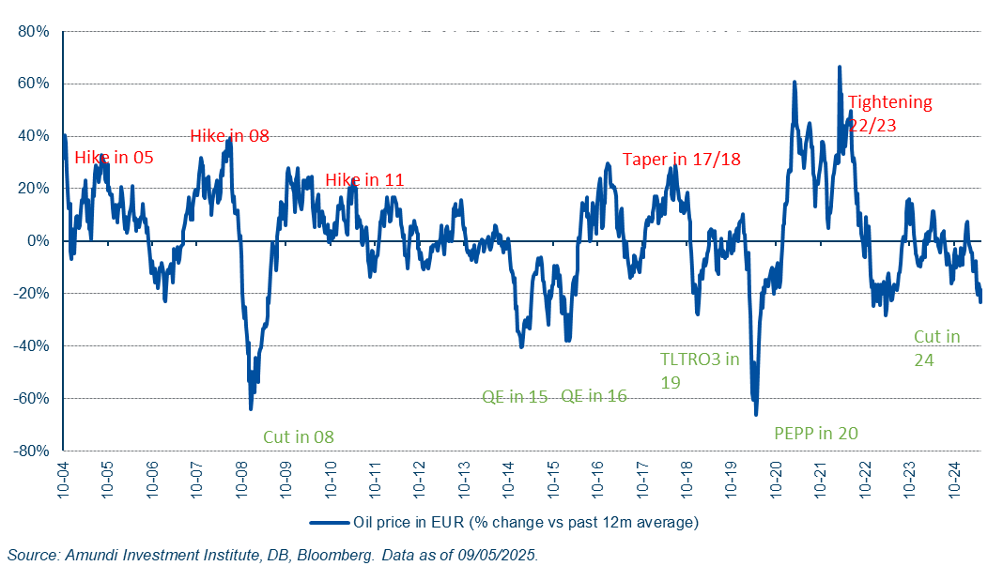
ECB was historically quite pro-cyclical on oil price

Slide 60
Policy uncertainty at all time highs post Liberation Day

Slide 61
EUR 5Y5Y inflation swap and Industrial Production
Germany – Level, Slope and Curvature drivers
Long term inflation to return to around 2.2%; Industrial production bottoming out from current through

Slide 62
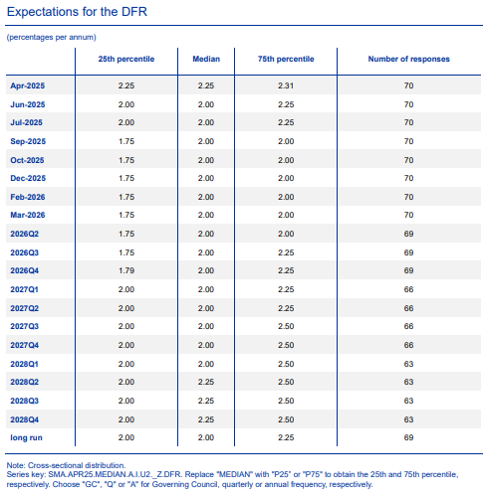
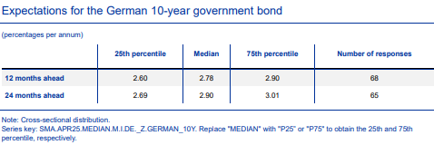

ECB Survey of Monetary Analysts
The survey period was from 31/03-02/04 2025 (released on 22nd of April) – post early March fiscal announcement
Feb 25
Increased from 2% in February

Slide 63
Cross Asset Research – TAA Update
Weekly update
May 2, 2025

Slide 64
Contents
TAA – Summary
Components
Performance

Slide 65
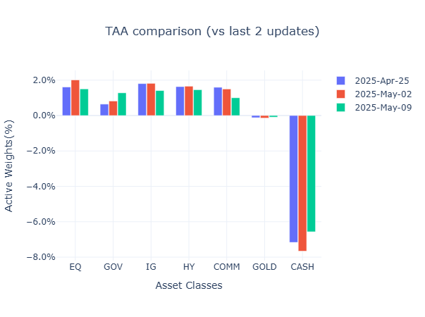
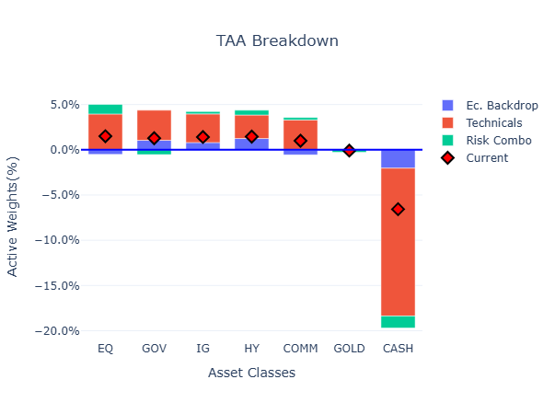
1. Summary
Cross Asset
Portfolio update
Another week of impasse
Main takeaways
Overall risk exposure remains stable
Improving technical risk-exposure masks wild swings in technical indicator: contrarian indicator swing from historic lows to highs in 2 weeks.
Overall sentiment worsens marginally
Institutional flows has seen further retreat as bonds and FX falter; cash positions increased back to historic levels awaiting developments in policy announcements and trade negotiation outcomes
FCI continue improving marginally but volatility remains main concern in US
CAST is stable but negative earning revisions and FCF yield continue worsening

Slide 66
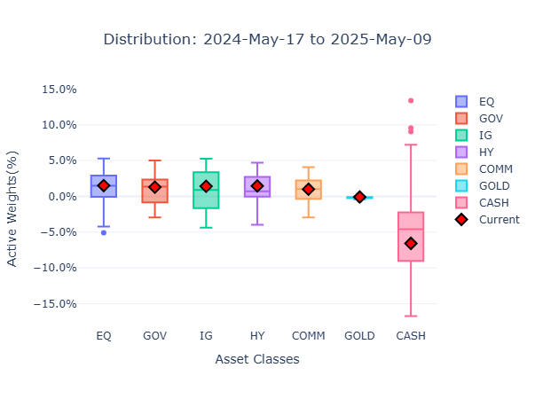
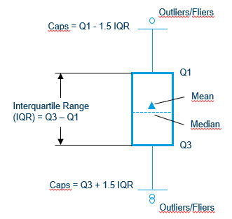
1. Summary – Distribution of allocations
Weeks of calm markets results in allocations in line with the 12month average

Slide 67
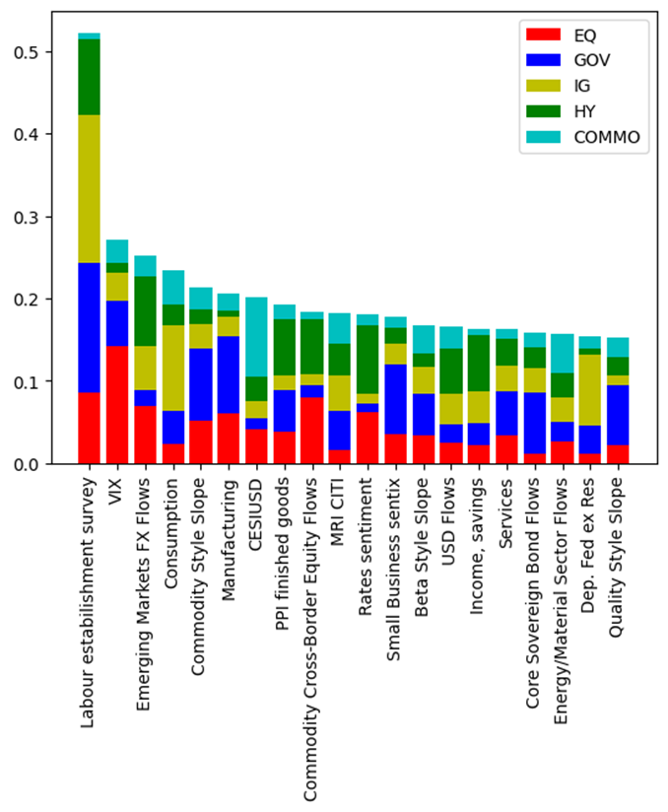
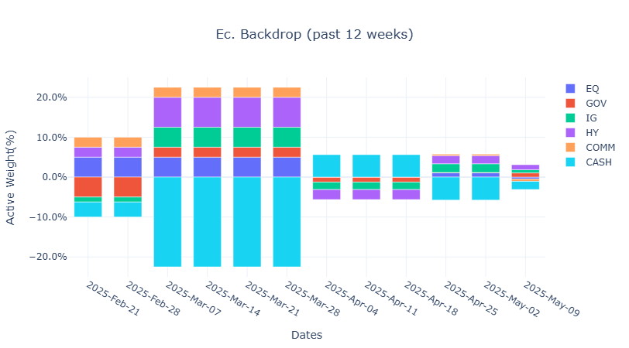
2. TAA Components – Economic Backdrop
Economic backdrop point to risk-on
Economic backdrop now leverages on Macro-Wealth Index (MWI) data, as well as detailed breakdown of institutional flows and market indicators for volatility (VIX and MOVE) and macro sentiments.
Latest analysis shows Labor establishment survey (MWI) and VIX to be the most relevant drivers of asset returns (equity, govies, IG, HY and commodities) going forward (right chart).
Marginal OW across all asset classes, with a slight preference of credit (both IG and HY) followed by equity

Slide 68
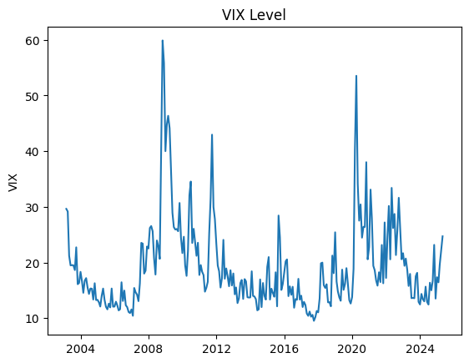
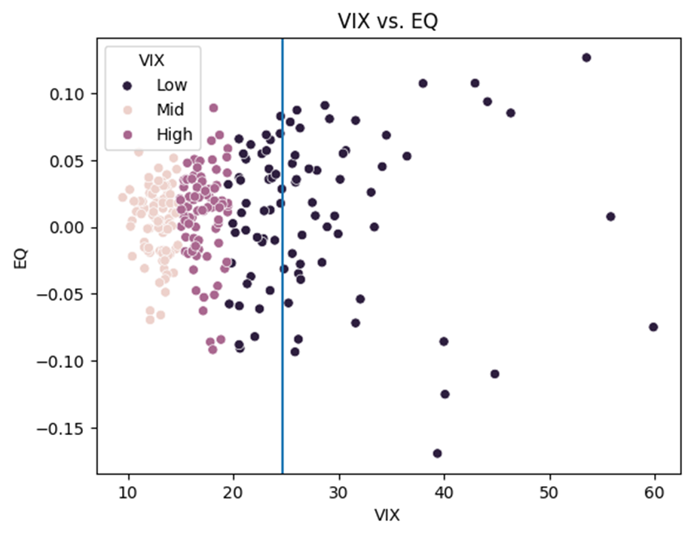
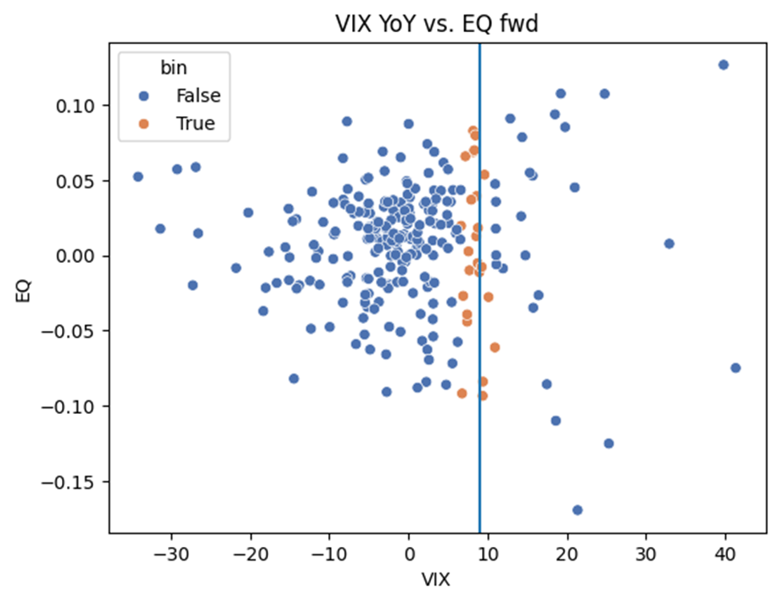
2. TAA Components – Economic Backdrop
Economic backdrop case for US equities – neutral tilt
VIX on 30/4 was at 24.7 representing a YoY change of 9.05
CBR analysis shows in the past higher levels and changes in VIX led to equity forward returns tending towards neutrality with wider dispersion

Slide 69
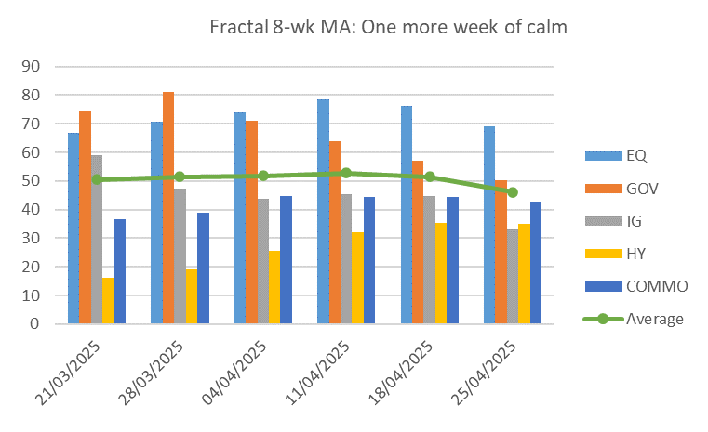
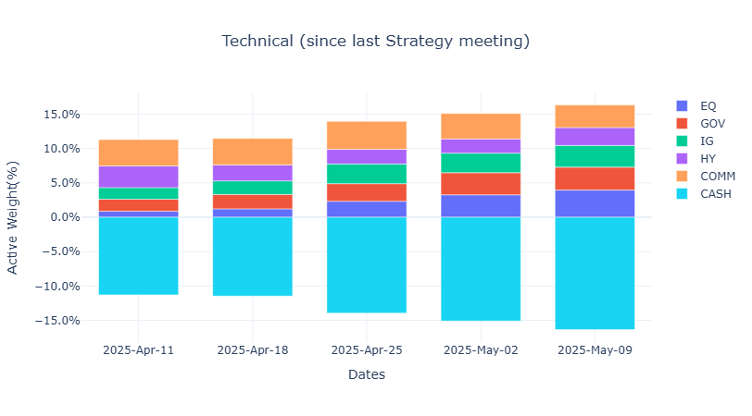
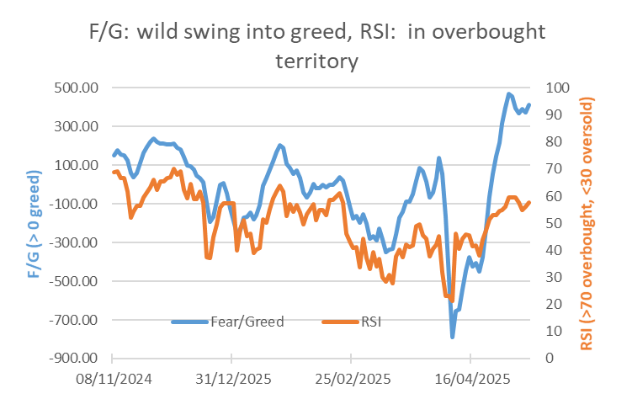
2. TAA Components – Technical Analysis
Fractals shift into safe assets
Recent market tranquility translates into an uptick in risk exposure
Latest update favors risky assets (part. equity + HY).
Equity contrarian signals continue to fluctuate wildly; F/G swing from historic lows to highs in 2 weeks

Slide 70


2. TAA Components – Risk Combo
Noticeable worsening of Financial Conditions;
Risk-combo status quo
Institutions have tracked back risk awaiting news from monetary authority and ongoing trade negotiations
FCI conditions have marginally improved as volatility measures remain steady
CAST remains as last week even as negative earnings and FCF numbers continue inching towards negative territory (a trend since January)

Slide 71


MoMo (Mood On/Off)
Risk-averse sentiment has retreated slightly vs last week awaiting fallout from tariffs
MoMo risk-off probability steady (78 vs 63% last week)
Institutional sentiment takes a step back in anticipation of upcoming announcements (CB and trade)
Flows to bonds (HY sovereigns) and HY currencies falter
Cash exposure increases yet again as cautious approach dominates institutional sentiments
Macro-risk aversion continue to be near Covid-era levels; macro data expectations continue to flirt neutrality

Slide 72



Financial Conditions
Deterioration across all regions (US, EU, and Emerging)
US FCI continue to be the only one in tightening conditions
Realized volatility continues to be the main concern, with other measures showing improvement since the tariff reprieve

Slide 73



CAST (Cross Asset Sentinel Threshold)
Earnings keep getting revised down
CAST remains as last week with stable once again but earnings and free-cash flow are now firmly in the alert territory
All other factors (USD, BAA-AAA and earnings yield) continue to be well in safe zone

Slide 74


3. Performance
Flat market for the week awaiting outcome of negotiations between US/China; HY best performer at +0.2%.
YTD performance for TAA: -0.73% (-0.02% last update)
YTD Ec. Backdrop: -1.09% (-0.01%)
YTD Technicals: -0.34% (-0.1%)
YTD Risk-combo: -0.74% (-0.01%)

Slide 75
G10 FX Strategy
May 2025

Slide 76

G10 FX – main convictions for the month
The USD correlation structure has changed, there’s little precedents to look for and this can have several implications from here. The USD is now positively correlated with equities and its correlation with US interest rates is now flat to negative. This to us means:
The USD lost portfolio construction characteristics and this per-se means lower demand than before
The best environment for the USD to sell-off goes in contrast with historical evidence (we set EURUSD @1.23 in a downside risk scenario and 1.10 for upside risk-scenario in 12M horizon. Baseline @1.17)
Improving trade talks are boosting risk-sentiment and short-term translate into USD strength as per the point above. This is also happening because of:
USD is diverging from rates differential
Consensus shifted rapidly short USD
Speculative and options positioning are short USD
If the sharp turn-around and the lack of visibility suggest to keep exposure low, we still see the USD bearish trend as the most likely.
The US rates advantage is not in line with growth differential (both data changes and data surprises are not showing a USD premium)
The Gold divergence with US real rates suggest the USD can undershoot rates differentials (as it happened in 2017-2018)
Steeper US curve is USD negative and lower tariffs should be less of a worry for inflation, thus the FED
The USD did not breach in April its fair valuation and real money have space to sell USDs
The more equities rebound the higher the more the asymmetry gets negative (the world will still see higher tariffs than before)
Lower tariffs cut downside for the RoW and will not redirect aggregate demand towards the US (given the lower trade-off)
Upside triggers (USD+)
Renewed spikes in oil, boost in risk-sentiment and US rates moving higher
USD funding lines breaking-up and leading to surge in USD demand
Downside risks (USD-)
Faster correction in inflation with no recession and the FED cutting rates (Goldilocks for longer)
US slowing down, with a reacceleration in sentiment in the RoW
Sharp deterioration in activity forcing the FED to cut aggressively

Slide 77

G10 FX – PTF update (May 2025)
We take profit on AUDCAD and trim exposure on JPY, given the risks of prolonged positive sentiment in the short-term. For now we consume little risk-exposure, given the lack of visibility and the symmetric risks

Slide 78

G10 FX – Performance review (May 2025)
We were noticing a change in correlation and we were seeing tariffs as less of a positive for the USD than consensus. In our framework, growth shocks were not easy to be diversified with USD exposure.

Slide 79

1. The USD correlation structure has changed
The USD is losing its role in PTF construction.
In the last 15 years demand for USDs was not just function of US exceptionalism. Portfolio construction features were big part of the equation. Yet this also means that when risk-sentiment bounces, the USD follows (as it happens right now)
Source: Amundi Institute, Bloomberg, data as of May 09, 2025

Slide 80


2. The USD correlation structure has changed
If this means investors are demanding higher risk-premium to hold USDs, it is also an alert when the window gets less USD negative (positive risk-sentiment)
Source: Amundi Institute, Bloomberg, data as of April 14, 2025

Slide 81


2.1 The USD correlation structure has changed
DXY should trade around 106 based on implied policy rates differential.
Source: Amundi Institute, Bloomberg, data as of May 09, 2025

Slide 82


2.2 The rapid shift in consensus is always a risk
In FX, being consensus is always a risk and the surge in expectations are a headwind from here. Yet we remain far from the improved valuation and it has been mostly a mark-to-market story
Source: Amundi Institute, Bloomberg, data as of May 09, 2024

Slide 83

2.3 Speculative and option positioning are short USD
Fast money and risk-reversals are telling
Source: Amundi Institute, Bloomberg, data as of May 09, 2025

Slide 84


3. Growth differential are less USD positive though
Both data changes and data surprises are not aligned with huge US rates advantage, despite the weak profiles out of the US
Source: Amundi Institute, Bloomberg, data as of May 09, 2025

Slide 85


3.1 Gold decoupling and YC steepening support USD- trend
Gold has decoupled with RY since a while, rates differential can fade to drive FX like it happened in 2017-early 2018 and YC steepening is USD-
Source: Amundi Institute, Bloomberg, data as of May 09, 2025

Slide 86


3.2 Gold decoupling and YC steepening support USD- trend
This is the case even for models that take into account relative productivity and degree of openness of G10 economies (BEER III)
Source: Amundi Institute, Bloomberg, data as of April 30, 2024

Slide 87


3.3 Real money have still space to sell USDs
This is the evidence we get from State Street
Source: Amundi Institute, Bloomberg, data as of May 02, 2025

Slide 88
3.4 The US equities rebound still has problems
The US will at least pay part of the economic cost. A headwind given expectations did not capitulate yet. Moreover, redirecting trade flows (which seems to be the goal of the US administration) can only be achieved in a weak USD window
Three possible scenarios for US tariffs
 | Perfect currency offset | No currency offset (1) | No currency offset (2)
Trade-partners FX | Exporters' currencies depreciate by the same amount of the tariffs increase | Exporters do not let their currencies to depreciate much | Exporters do not let their currencies to depreciate much
Incidence | Tariffs are paid by the tariffed nation (reduced purchasing power and wealth from weaker currency) | Tariffs are paid by US consumers as imported goods cost more | Tariffs are paid by US corporates as the higher import prices are absorbed by margins
US Inflation | Non-inflationary (after tariffs USD price unchanged) | Inflationary (after tariffs, USD prices rise) | Non-inflationary (margins absorb the costs)
Trade flows | As import prices do not increase there are little effects on trade-flows. As the USD strengthens, this hit exports) | Rebalancing is achieved over time as imports get more expensive relative to domestic production | Rebalancing is achieved over time as imports get more expensive relative to domestic production
Revenues | The Treasury raises revenues | The Treasury raises revenues at first, but as trade rebalances away from tariffed goods, less revenues are raised over time | The Treasury raises revenues at first, but as trade rebalances away from tariffed goods, less revenues are raised over time
US Growth | Marginal directional impact on growth | Higher consumer prices should drag US growth, all else being equal | Lower margins should drag US Earnings
Source: Hudson Bay Capital, Amundi Investment Institute. February 2025

Slide 89



3.4 The US equities rebound still has problems
SP500 EPS downward revision is not extreme and still open up for negative surprises. Peaking relative growth may gradually require a shift in capital allocation
Source: Amundi Investment Institute, Data is as of April 29, 2025

Slide 90


4. Capital repatriation remains a theme
Foreign holdings of USD securities at all time high. The starting point may favour a de-dollarization wave. This can also turn out to be a tool to counteract the US administration threats on trade.
Source: Amundi Institute, Bloomberg, data as of April 28, 2025
Source: Department of the Treasury/Federal Reserve Board, TIC, Amundi Investment Institute. Feb 2025, which refers to data as of June 2024 (annual data)

Slide 91

4. Capital repatriation remains a theme
Bonds flows are a positive for EURUSD this time. The capital we have allocated into US debt is huge. Repatriation or higher hedge ratios in bonds allocation is a headwind for the USD, in our view.
Source: Amundi Institute, Bloomberg, data as of February 28, 2025

Slide 92
Contents
Guidelines:
Contents are fixed according to the meeting structure and are meant to be consistent across all investment platforms
Main Scenario – Cross Asset Research & Portfolio Construction
DM Rates
DM Equity
DM Credit
EM Equity
EM Debt
Global FX
Commodities
Hedging
Asset Class

Slide 93
DM Rates focus group
Strategy Day
MAY 2024
• Document for professional investors only

Slide 94




DM Central Banks Implied policy rate
Curves have shifted higher since last Strategy Day

Slide 95

US Rates: fairly priced as policy volatility continues
Long US 5Y or 2Y still attractive as Fed would react asymmetrically to labour market weakness
US treasury yields rising again in recent days due to
optimism around tariff de-escalation and trade agreements with UK and China (Trump caving in?), reducing the recession risk
Last week’s Fed meeting also confirmed the FOMC is not ready to be pre-emptive, and will wait for the hard data to confirm any growth slowdown
If US employment does rise sharply the Fed will act, and likely cut quickly despite higher CPI from tariffs. Long US 5Y (or 2Y) still looks good risk/reward for this scenario, since rates are not priced for a US recession, but the probability of this scenario is reducing in recent days.
At the longer end, the steepening mostly indicates repricing of term premium amid policy uncertainty. We remain cautious on the US long end, with US deficit set to rise further, concerns around overseas demand, poor US fiscal credibility and bond-negative noise around the new tax bill.
However a rise in 10y yields towards 5% would present a buying opportunity, as the market will be a brake on Trump’s policies, and both Fed and Treasury have tools to push back on a excessive bear steepening.
FOMC Meetings - Market Pricing (12th May)
Source: Bloomberg, 12th May 2025.
For 2025 the market now prices 2 x 25bp cuts (55bp of cuts) for 2025, around 25bp less than last time, and down from 100bp of cuts at the end of April.
Fed rates priced to fall by cumulative 100bp by January 2027 to a rate of around 3.25%-3.5% (SOFR around 3.35%), around many estimates of nominal neutral rates.
Despite the recent volatility, market pricing shifted only modestly, with a gradual easing cycle priced to cut close to neutral but not accommodative.

Slide 96
US Treasuries: scenario analysis
 |  | BULL SCENARIO | DM RATES CENTRAL SCENARIO (updated) | BEAR SCENARIO
GROWTH (GDP) |  | US recession, UR rises towards 6% | Slowing but no recession, UR rises towards 4.5% | Growth slowing modestly and UR steady
INFLATION (Core PCE) |  | Fed looks through rise in inflation due to tariffs (once off impact) | CPI rises sharply but uncertainty on second round effects | Reacceleration of inflation forces Fed to remain on hold
FED POLICY (Fed rate) |  | Fed cuts rapidly on US recession End 2025: 3.00% End 2026: < 2.5% Fed restarts QE? | Fed on hold in H1 but likely to resume cuts in H2 2025: End 2025: 3.75-4.0% End 2026: 3.25-3.5% | Fed on hold (high for longer), target rate stays at 4.25%-4.50% in 2025. US long end yields at or above 5%
Consequences on US yields (on a 3-6 month horizon)
US yields | 2Y | 2.5% | 3.5 - 4.0% | 4.0-4.25%
 | 5Y | 3.25% | 3.5 - 4.0% | 4.5%
 | 10Y | 3.5% | 4.0 - 4.5% | 5.0%

Slide 97

Long EUR duration: maintain long EUR 5 and 10y
Path toward neutrality is in place as risks to growth remain to the downside (due to lower confidence, geopolitical risks and still tight financing conditions) and the disinflation process is well on track
Growth: tariffs to weigh. Eurozone Composite PMI marginally contracts in April. Improvement of the manufacturing sector, likely to own to a front loading ahead of tariffs. Absent some retro-pedalling tariffs shock may weigh heavily on activity. Mega German stimulus should help to buffer the impact, even though likely to be felt from 2026 only.
Inflation: risk of undershooting are increasing. CPI is expected at 2.1% in 2025 and 1.9% in 2026 (both Amundi and BBG consensus). The impact on inflation of a trade war increases uncertainty over the expected path ahead, not clear in which direction (while definitely impacting to the downside economic activity).
ECB: neutrality approaching. Path of monetary policy becomes more data dependent. Near term data flow likely to support a dovish bias due to lower energy prices, higher Euro, fragilized activity, higher long term rates. Disinflation process still looks well on track. On still elevated services inflation, the ECB is confident that wage growth will moderate.
ECB Meetings - Market Pricing
Markets are pricing ECB depo slightly above our target of 1,50%

Slide 98
Long 5Y swap EUR duration: maintained
Rates have risen marginally late April and early May on the short end of the curve, on a backdrop of resilient hard data and recovering equity markets. Forwards anticipate ECB rates above 1.50% for end 2025 (our central case). Terms from 2027 on and beyond, are close to, or above 2%. Near term news flow (disinflation, fragilized activity), is likely to support a dovish bias by the ECB.
Current pricing still offers value
Keep long on 5Y swap
Source: Bloomberg, Amundi

Slide 99
Long 10Y swap EUR duration: maintained
Long term forwards have barely moved since the announcement of tariffs, and remain substantially above their level of end 2024. At around 2,90%, 5X5 swap rate remains substantially above most R* gauges even after their upward adjustment induced by the German stimulus plan
5x5 swap rate still offers value
Keep long on 10Y swap
Source: Bloomberg, Amundi

Slide 100

Long 10Y UK Gilt: maintain
Growth: looking at April’s PMIs, UK still positioned relatively worse than US and EZ on both the services and manufacturing side and on the employment component. Prices: both manufacturing and services (and for both input and output prices) still trending upwards.
Inflation: March data slightly below expectations, MoM 0.3% (vs 0.4%), YoY at 2.6% (vs 2.7%). CPI services back to below 5% (4.7% vs 4.8% expected). Inflation has been close to BOE’s target but is expected to rise in April, with energy and regulated prices driving up inflation temporarily (peak in Q3 25 is actually seen to stabilize lower than before by BOE, @ 3.5% vs 3.7%). Average weekly earnings growth has picked up but is expected to moderate.
Monetary policy: BOE’s forward guidance reiterated “careful and gradual approach to further withdrawal of monetary policy restraint”, which is still hinting at 1 cut per quarter until the end of this year (in line with both Amundi’s and market consensus). Markets removed 1 cut from this year’s pricing after May’s BOE meeting, which leaned hawkish in the vote tally. The new set of macro projections the MPC tilted slightly dovish, with a softer inflation outlook partly reflecting weaker demand following US tariff increases, which also affects the growth outlook.
We keep maintaining the long Gilt as:
US-UK deal was overall a non event, more a marketing exercise, with only some exemptions to UK’s 10% tariff (therefore almost no impact)
Medium-term equilibrium rate pricing is still too high (2-5 years ahead from Market Participant survey @ 3.25% vs 3.8% priced in the GBP curve), suggesting increased term premium embedded in valuations. If volatility eases further the term premium should compress.
Growth expected below both consensus and BOE should support some compression between Gilts and Treasuries.
Chart 1: Gilts still outperforming Treasuries since Liberation Day
Chart 2: BOE rates expectations and current pricing next 12 months

Slide 101


Short 10Y JGB: global tariffs complicates BOJ policy
Upward pressure on Yen
US-Japan tariff negotiations started but still visibility is too low
Japan-US tariff negotiations have as a consequence a big impact on Yen appreciation.
Yen appreciation could squeeze exporters’ profit and reduce imported inflation, curb domestic investments and weaken wage growth
Market is pricing a BOJ on hold this year
Valuation still excessive with real yield still in negative territory
QE still strong and its reduction/stop can put pressure on long term yields
Source: Bloomberg. Data as of 09/05/2025.

Slide 102

Long BTP-Bund: long position confirmed
Reference (target) level 90 bps
S&P upgraded Italian rating to BBB+, maintaining the outlook stable, citing a primary budget surplus over 2025-2028.
Italian recovery exceptionalism: the recovery since the pandemic years has been capex-driven (Superbonus, RRP infrastructure spending) and it is fading.
Cyclical recovery instead is underway and implementation of the Recovery and Resilience Plan should continue.
Fiscal outlook improving: last Italian ISTAT data published shows a better than expected deficit and a +0.4% primary surplus in 2024, beating the rest of G7 countries.
In relative terms Italy looks better versus both France and Germany on a geopolitical point of view and on growth/deficit dynamics even if we consider the new potential German fiscal package.
Source: Italian Government, Credit Agricole CIB

Slide 103
Contents
Guidelines:
Contents are fixed according to the meeting structure and are meant to be consistent across all investment platforms
Main Scenario – Cross Asset Research & Portfolio Construction
DM Rates
DM Equity
DM Credit
EM Equity
EM Debt
Global FX
Commodities
Hedging
Asset Class

Slide 104
DM equities
May 2025

Slide 105
FOCUS GROUP DM EQUITY
The path of the new US administration’s policies (such as Tariffs, Tax cuts, Immigration) are difficult to evaluate given the wide range of potential outcomes.
While we do expect further downward revisions, the impact on EPS 2025 seems so far manageable
Margin expansion in the US & fading EPS growth differentials vs other markets continues to drive rotation towards cheaper markets
Global growth, while slowing, should provide decent earning growth. In this environment, we believe it is important to diversify by regions and styles
DeepSeek was the first wake up call” which triggered a portfolio adjustment at a Global level. The growing tensions within the transatlantic alliance was a second “wake up call” which highlighted the urgency to scale up Defense/Infra spending in Europe. In the short term, within DM space, Eurozone seems the major beneficiary of these developments

Slide 106


« Unpredictability » is here to stay, « approval rate » & « market behaviour » were clearly watched
Presidential Approval vs Consumer Confidence

Slide 107








Corporate Transcript Mentions: SP500
“Tariffs”
“Cost Pressures”
“Raising Prices”
“Pass on Costs”
“Consumer Weakness”
“Margin Pressure”
“Capex”
“Layoffs”
Source: AlphaSense, Haver Analytics, Morgan Stanley Research (latest data: 8th of May 25)
Source: Amundi Investment Institute, Data is as of April 14, 2025

Slide 108



Positive & Negative EPS Guidance (12w rolling): SP500 & Stoxx 600
S&P 500
Stoxx 600
Nikkei
The narrow range of Corporates’ “guidance” (up/dwn) provided during the reporting season, where the “Net” remains in positive territory for the US and marginally negative in the case of Europe, suggests that corporates are in “wait & see” mode waiting for clarification
Source: Amundi Investment Institute, Data is as of April 14, 2025

Slide 109


Q1 % of companies beating: SP500 & EuroStoxx
% of S&P 500 companies beating quarterly EPS and sales estimates
% of EuroStoxx companies beating quarterly EPS and sales estimates
Of the data available for EuroStoxx companies that reported (ca 82% of the index), 66% beat EPS estimates
Of the data available for S&P 500 companies that reported (ca 85% of the index), 77% beat EPS estimates surprising positively by 9%
Source: Amundi Investment Institute, Data is as of April 14, 2025

Slide 110




EPS revisions: DM equity
ERI – weekly as of 9th of May
Source: Amundi Investment Institute, Data is as of April 14, 2025

Slide 111

PERFORMANCES
MAIN AREAS - PERFORMANCES

Slide 112
KEY METRICS
MAIN AREAS EPS growth

Slide 113
VALUATIONS

Slide 114
VALUATIONS
USA & ZONE EURO

Slide 115


Index contribution to CY’25 EPS: SP500
Nvidia Mag 7 x Nvidia S&P x-Mag 7
Despite the high level of uncertainties and weakening market sentiment, the Magnificent 7 did stand out yet again and this translated into no aggregate full-year outlook change (ps: Nvidia will report on the 28th)
On the contrary, expectations for the rest of index (the other 493 stocks) continued to be revised down
Source: Amundi Investment Institute, Data is as of April 14, 2025

Slide 116




IT sector news-flow: Apple
Old
Source: Amundi Investment Institute, Data is as of April 14, 2025

Slide 117



Semiconductors: Memory & TSMC
DRAM spot price trend
TSMC monthly sales in April reached a new all-time high (+43.5% YoY). Two factors could be at play:
1) rushed demand to secure critical components ahead of impending global tariffs
2) growing demand for 3nm and 5nm process
Memory pricing increasing due to 1) pull-in demand from buyers in response of the suspension of tariffs on electronics 2) tightened supply by major DRAM players
NAND spot price trend

Slide 118

US semiconductors: Q1 Cloud Capex still on track despite multiple concerns (ie. Ai efficiency, DeepSeek, China restrictions
While Q1 global hyperscale of $92.0bn came in slightly below consensus $93.8bn on quarterly lumpiness, most hyperscalers expressed for continued strong AI investment throughout CY25 and growth into CY26.
GOOGL/MSFT reiterating their CY25 (FY26 for MSFT) views and META raising its CY25 guide to $64-72bn from $60-65bn prior. While most refrained from giving CY26 outlook, MSFT noted it expects overall capex to increase YoY, with the mix of short-lived assets (servers, CPUs, GPUs) also expected to rise vs. long-lived assets (buildings, land). AMZN did not provide an update to its $105bn CY25 outlook
According to a consensus tracker, it now indicates CY25/26 capex of $414bn/$432bn, up +44%/+4% YoY. This is 300bps/100bps higher than pre-earnings outlook of $402bn/$429bn, or 5090bps/4900bps higher than one year ago (May-2024).
While CSPs did not provide much colour on 2026 spending outlook yet, we view the overall spending environment as still robust, particularly now that the “AI Diffusion rules” are scrapped, opening doors for sovereign AI infra buildouts in most countries
Source: Amundi Investment Institute, Data is as of April 14, 2025

Slide 119




EPS expectations: SP500
Old
Source: Amundi Investment Institute, Data is as of April 14, 2025

Slide 120


Index levels: SP500
Despite the high level of uncertainties and weakening market sentiment, the Magnificent 7 did stand out yet again and this translated into no aggregate full-year outlook change (ps: Nvidia will report on the 28th)
On the contrary, the rest of index (the other 493 stocks), in aggregate was again the major drag
Source: Amundi Investment Institute, Data is as of April 14, 2025

Slide 121



EPS expectations & sensitivity: Topix
Source: Amundi Investment Institute, Data is as of April 14, 2025

Slide 122


Flows: Japan
Japan corporate remained very active announcing Y3.8t of buyback in April alone vs Y1.3t last year, Y0.7t the year before
Restructuring seems accelerating (ie. Toyota Industries, Kyocera, Sony ..)
Source: Amundi Investment Institute, Data is as of April 14, 2025

Slide 123
Contents
Guidelines:
Contents are fixed according to the meeting structure and are meant to be consistent across all investment platforms
Main Scenario – Cross Asset Research & Portfolio Construction
DM Rates
DM Equity
DM Credit
EM Equity
EM Debt
Global FX
Commodities
Hedging
Asset Class

Slide 124
Strategy Day DM Credit group
May 2025

Slide 125
Our views in a glance
Euro IG | Euro HY | US IG | US HY
POSITIVE The most attractive segment despite the recent move wider. Better RV, better demand, ECB support. | NEUTRAL More attractive than US HY and supported by technical (resuming inflows, supply limited) | NEUTRAL Recent widening gave back a little bit of attractiveness but the environment is still noisy. | NEUTRAL Valuations are a bit more attractive but remain expensive given current economic backdrop
Macro
Fundamentals
-
IG: metrics are ok, earning season is good but guidance is unclear.
HY: discrepancy between high / low ratings, but things are stabilizing even for CCCs.
Defaults heavily depending on tariffs impact: ranging from 3-7% in 12m
A few Tariffs deals are boosting sentiment, but new rates will drag global growth lower. Hard data holding on well vs soft data at the moment. Europe better positioned.
Inflation path remains clearer in Europe than in US
Technicals
Valuation
Flows: buyers finally back after a few weeks of outflows, especially on long date paper. Books 3-5x (vw, AT1)
Issuance: volatility kept YTD net supply in negative territory, expecting now more to come as seasonality headwinds for cash bonds.
NIP turned positive for financial and non financial sectors.
Valuations vs swap are fair in Europe, and improve in the US on the back of recent widening (still expensive though).
Synthetic recently outperforming cash bonds, given huge underperformance following liberation day. We expect the trend to continue, given seasonally elevated supply in May.
Relaxation around tariffs and a few deals boosted sentiment: spreads now more attractive vs govt and lagging equity during recent risk-on. There is room for further tightening. We maintain a slight constructive view in a volatile environment.

Slide 126
Long EUR IG
Strategy | Long EUR IG Credit
Group | DM Credit
Assets | Ticker | Size / Duration | Horizon (Date) | Upside Decision Level (in bp) | Downside Decision Level (in bp)
EUR IG | iTraxx Main | 0,4 | Feb 2025 | +10 | -8
Upside Catalyst
Growth moderating in the US (no recession) / improving in Europe
Fundamentals strong : corporates full of ammunition in case of a sudden macro shock
Credit benefits from a “boring” growth & slowly decelerating inflation backdrop
Still Supportive technicals
Downside Catalyst
Sharp deceleration of US growth (monitor the consumer)
Return of volatility (such as the carry yen unwound / fear of US recession episode)
Increasing political and geopolitical tensions
Idiosyncratic stories potentially leading to liquidity risk (very low probability as the recent default cycle was more broad based than specific of a sector)
Scenarios
Favorable scenarios | Unfavorable scenarios
Slow disinflationary trend persisting Positive growth surprises Supportive technicals More visibility on the FED policy lowering the market volatility | Weaker growth and / or sharp fall of inflation leading to lower rates Negative geopolitical shock Debt sustainability crisis Fading technicals

Slide 127




Valuations
Valuation

Slide 128

Cash and Syntetic valuations

Slide 129


Credit spreads cheaper than govt spreads
Valuation

Slide 130

Where do spreads stand relative to historical standards?
Valuation

Slide 131


DTCC Positioning
EU
US

Slide 132

CTAs positioning

Slide 133

Cash Bonds Beta

Slide 134

Decompression after unusual compression

Slide 135

Flows

Slide 136


Flows almost flat in April for EUR IG, on opposite trends in curve segments, negative for HY, though recently improving
Technicals
Source: EPFR, Barclays

Slide 137

EU flows
Technicals
Source: EPFR, Barclays

Slide 138

Modest outflows in the end
Technicals
Source: EPFR, Barclays

Slide 139


US IG and US HY flows
Technicals
Source: BofA, EPFR.

Slide 140
OIS: Corporate Bond Valuation
Valuation
5

Slide 141

Following liberation day announcement, Moody’s “now expects the one-year-ahead global default rate to range from 3% to 7%”.
Moody’s revised its baseline scenario after US tariffs announcement

Slide 142


Global HY default slightly lower in March, as US down to 5.8% from 6.1%
In Mar Global HY DR was down to 4.5% from 4.7% in Feb, with Europe stable at 2.5% and US down to 5.8% from 6.1%
Low rated names still concentrating defaults in this cycle, as CCC at 10% in US, while BB and B close to flat levels.
CCCs concentrate defaults in Europe but at half the levels in US.

Slide 143


US HY distress ratios ticked up in April and March in US, despite still quite low by historical standards, Europe slightly rising, too in April

Slide 144

Maturity Walls

Slide 145

NIP

Slide 146
Flows

Slide 147
Flows almost flat in April for EUR IG, on opposite trends in curve segments, negative for HY, though recently improving
Technicals
Source: EPFR, Barclays

Slide 148
Inflows into EUR IG short-term also in April, despite no further curve steepening and the spike in volatility
Source: EPFR, Barclays
Technicals
Source: EPFR, BofA

Slide 149




EUR IG: net supply negative also for financials in April, while gross supply still decent despite the stop-start.
Source: Bloomberg, Amundi Institute
Source: Bloomberg, Amundi Institute
Technicals

Slide 150

Demand improving more gradually in US IG, following three weeks of negative flows, short-term funds included
Technicals
Source: BofA, EPFR.

Slide 151

Demand was back into US HY last week, following quite a one week drawdown in the aftermath of “liberation day”
Technicals
Source: BofA, EPFR.

Slide 152
Technicals

Slide 153
April impacted by the “liberation day” in both demand and supply trends: finally technicals are recovering and May looks a potentially busy month for supply
Demand flows turned negative in all credit asset classes in April, though to a different extent.
EUR IG felt less than US IG and global HY the negative impact on flows, as: 1) they were more modest thanks to persisting inflows into short-term funds, 2) meaningful outflows lasted two weeks only, less than in US
In Eur credit markets HY were more hit by outflows, despite the strongest one week outflows were recorded in US HY: both asset classes are recently recording a recovery in demand.
Corporate issuance was stop-start in April as volatility spiked, and a late burst of supply did not fully-offset the initial dearth.
Net supply was negative in European IG not only for non-financials but this month also for financials, despite still decent overall volumes of gross supply.
Net supply was negative for US HY as well, while primary market activity, despite slowing down significantly was more resilient in US IG space, with burst of supply in EUR IG at the end of the month also buoyed by a number of large multi-tranche deals from US names.
This sets up May to be quite busy on the supply side, at least during periods of calm, while demand flows are likely to return positive.
Technicals

Slide 154


Strong start of the year for primary market activity in US IG credit markets, despite the slowdown in April slow down
Technicals

Slide 155


Net issuance turned negative for US HY in April, following a good Q1 volumes
Technicals

Slide 156


M&A funding rising among issuance purposes, year to date at 19% vs 13% last year, but on still low overall volumes.
In 2024 issuance purposes were concentrated in refinancing needs, representing roughly 70% of supply.
M&A driven volumes recovered some ground in Q4, while year to date activity saw a further rise of this component to 19% (from 13% average in 2024), despite on modest overall volumes.
Technicals

Slide 157




Credit wall of maturities: source BofA ML
Source: BofA
Source: BofA
Technicals
Source: BofA
Source: BofA

Slide 158
Fundamentals
03

Slide 159

Corporate fundamentals (as of Q4 2024)
Fundamentals

Slide 160

Corporate fundamentals (as of Q4 2024)
Fundamentals

Slide 161


Corporate fundamentals (as of Q4 2024)
Fundamentals

Slide 162

Corporate fundamentals (as of Q4 2024)
Fundamentals

Slide 163

Corporate fundamentals (as of Q4 2024)
Fundamentals

Slide 164

Corporate fundamentals (as of Q4 2024)
Fundamentals

Slide 165


Still limited spillover from higher rates on IG debt service, while among HY, the impact was mostly felt by lowest rated issuers
Fundamentals

Slide 166
Defaults

Slide 167
HY default rates eased to 4.5% in March, still expected to fall by Moody’s in one year baseline scenario, though at a higher than previously expected level
In March Global HY default rate eased to 4.5% from 4.7% in Feb, with Europe stable at 2.5% and US down to 5.8% from 6.1%.
Defaults keep being concentrated in est rated names and SMEs story: CCCs are still at 10% in US, while BB and B both at 0.0%, while in terms of debt volumes default rates are still low by historical standards, below 2% both in US and Europe.
Moody’s baseline scenario keeps pointing to a fall of global HY defaults, but final estimates in 12-mo were revised slightly up from 2.5% to 3% and to point to a wider range, depending on tariffs outcome: “While our baseline forecast is for the default rate to decline during 2025, it would not take a big negative shock for it to rise instead. Our 12-month forecast is for a range of 3%-7%.”
The trend in global default rate is still expected to be driven by US, as the outlook for European HY default rates points to a modest increase to the 3%, not far from current 2.5%. Interestingly, the peaks in Moody’s pessimistic scenarios have not been revised higher. We expect EUR HY default rates to remain lower than US HY default rates, on the back of a better combination of monetary policy, more limited impacts from tariffs risks and higher average credit quality.
Moody’s rating migration over the last year recorded: 1) an overall positive drift in mid-high rated HY and low rated IG, 2) negative trend in low rated HY. Volumes of rising stars are still higher than volumes of fallen angels.
In terms of ratings, Moody’s expects default rates to remain close to flat in BBs, contained among Bs in one year time, revised down for CCCs. Rising stars still expected to outweigh fallen angels in 12 months
HY distress ratios were slightly up in Europe in April, rose more in US but still close to historical low levels: US HY distress ratios by sectors keep showing no sector issue, but more sectors moving at higher distress levels. Moody’s one-year default rate forecasts shows no sector issue, too.

Slide 168
Global HY default slightly lower in March, as US down to 5.8% from 6.1%
In Mar Global HY DR was down to 4.5% from 4.7% in Feb, with Europe stable at 2.5% and US down to 5.8% from 6.1%
Low rated names still concentrating defaults in this cycle, as CCC at 10% in US, while BB and B close to flat levels.
CCCs concentrate defaults in Europe but at half the levels in US.

Slide 169


Default rates still an SMEs story, as in debt volumes are still low by historical standards, lower than 2% both in US and Europe
Default rates calculated on debt volumes were slightly down in March, both in US and Europe below 2%, remaining quite low by historical standards.
The picture of default rates calculated in volume terms is also in favor of higher rated names, as defaults are almost only a CCC story.

Slide 170

Following liberation day announcement, Moody’s “now expects the one-year-ahead global default rate to range from 3% to 7%”.
Moody’s revised its baseline scenario after US tariffs announcement
The current tariffs and trade turmoil will weaken credit conditions and corporate defaults will not decrease as quickly as we had previously expected.
In fact, the global default rate may remain elevated or rise depending on the degree of negative impact that tariffs will have on economic and financial conditions.
While our baseline forecast is for the default rate to decline during 2025, it would not take a big negative shock for it to rise instead. Our 12-month forecast is for a range of 3%-7%.

Slide 171


Moody’s pessimistic scenarios for default rates not revised up…

Slide 172



…Actually slightly lower than one month ago in US, together with a higher baseline projection…

Slide 173



…while in Europe baseline forecast was only marginally revised higher

Slide 174


Default rates calculated on BofA benchmarks show US BBs at flat levels, Bs moved from 0.4% to 0%...
Source: BofA

Slide 175


…While US CCCs default rates kept decreasing from peaks (at 7% in April), while the distress ratio turned higher last two months
CCC default rate moved down over the last months, reached 7% in April from 20% peaks end 2023…
…while CCC distress ratio turned to the upside from Jan 25% to 40% in April.
Source: BofA

Slide 176

European HY default rates by ratings calculated on ICE BofA benchmarks show a picture very similar to US …
Source: BofA

Slide 177


…While the recent trend is mostly driven by German issuers among big four countries, with periphery issuers DR close to flat levels
Source: BofA

Slide 178


In Europe debt volumes of rising stars still higher than fallen angels’ volumes
EUR HY rising stars’ volumes, in EUR mn
EUR fallen angels’ volumes, in EUR mn
Source: BofA

Slide 179

Moody’s rating migration over the last year recorded: 1) an overall positive drift in mid-high rated HY and low rated IG, 2) negative trend in low rated HY
Last 12 months recorded an overall positive rating drift in mid to high rated speculative grade segments.
Low BBBs and high BBs also showed positive net migrations.
Low rated HY, on the contrary, suffered from net negative rating revisions

Slide 180


Default rates and rating transitions expected by Moody’s in 12-months keep moving in the same direction
Moody’s expects default rates to remain close to flat in BBs, contained among Bs in one year time, revised down for CCCs.
Rising stars still expected to outweight fallen angels in 12 months

Slide 181


In US rating migration still positive for IG, more mixed in HY
Source: BofA

Slide 182
US HY distress ratios ticked up in April and March in US, despite still quite low by historical standards, Europe slightly rising, too in April

Slide 183


US HY distress ratios by sectors keep still showing no sector issue, but broader increase, with five sectors in double digits territory
…Despite the number of sectors at double digits moved to three: most of sectors are still below 5%.
Source: BofA

Slide 184

Last quarterly surveys of bank lending standards published by Fed and ECB showed a stabilization following previous improvements
Last Fed Loan Officer Survey and ECB Euro Area Bank Lending Survey both recorded a slight rebound of the percentage of banks tightening credit standards to non-financial companies.
This last move followed a relatively steady downward trend started in 2023.

Slide 185



Combined signals from distress ratio, bank lending standards and expected macro growth support a benign picture for US HY default rate in 2025
US HY distress ratios pointing to much lower levels of defaults in one year (left hand chart)…
…While also the latest indication from bank lending standards still points to decreasing default rate levels (right up chart).
Gap between expected GDP growth and LT trend pointing to below LT average default rates in 2025 (bottom right chart).

Slide 186
Euro Curves (OAS)
Performances

Slide 187
US Curves (OAS)
Performances

Slide 188
Contents
Guidelines:
Contents are fixed according to the meeting structure and are meant to be consistent across all investment platforms
Main Scenario – Cross Asset Research & Portfolio Construction
DM Rates
DM Equity
DM Credit
EM Equity
EM Debt
Global FX
Commodities
Hedging
Asset Class

Slide 189
Macro Strategy
EM Equities
May 2025
• Document for professional investors only

Slide 190
Contents
Overview
Summary View
Investment Case Analysis
Current Positions – Long China (50bps)
Closed MSCI India (25bps)
Review EM Markets
Quant Analysis
Appendix

